Slide 1
Analysis of 11-years dynamics in spatial distribution of lightning density in North Asia
Tarabukina L.D., Kozlov V.I., Innokentiev D.E.
The Yakut Scientific Centre of the Siberian Branch of the Russian Academy of Sciences

Slide 2
Average annual lightning density (stroke/km²*year, log scale)
2009 - 2019
World wide lightning location network
(WWLLN) data
wwlln.net
>70 sensors worldwide
VLF (3-30 kHz)
WWLLN has highest detection efficiency, at 60–80%, for large‐amplitude strokes (>50 kA)
“Western” region
“Central” region
“Eastern” region

Slide 3
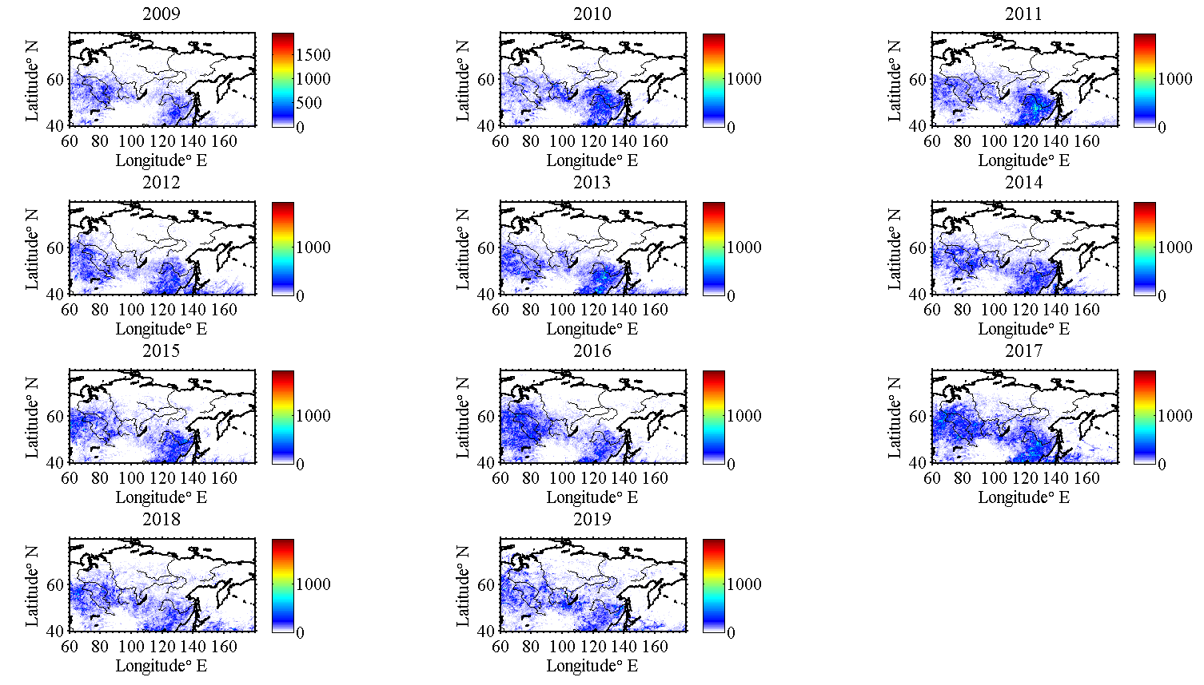
Annual spatial distribution of lightning number (linear scale)

Slide 4
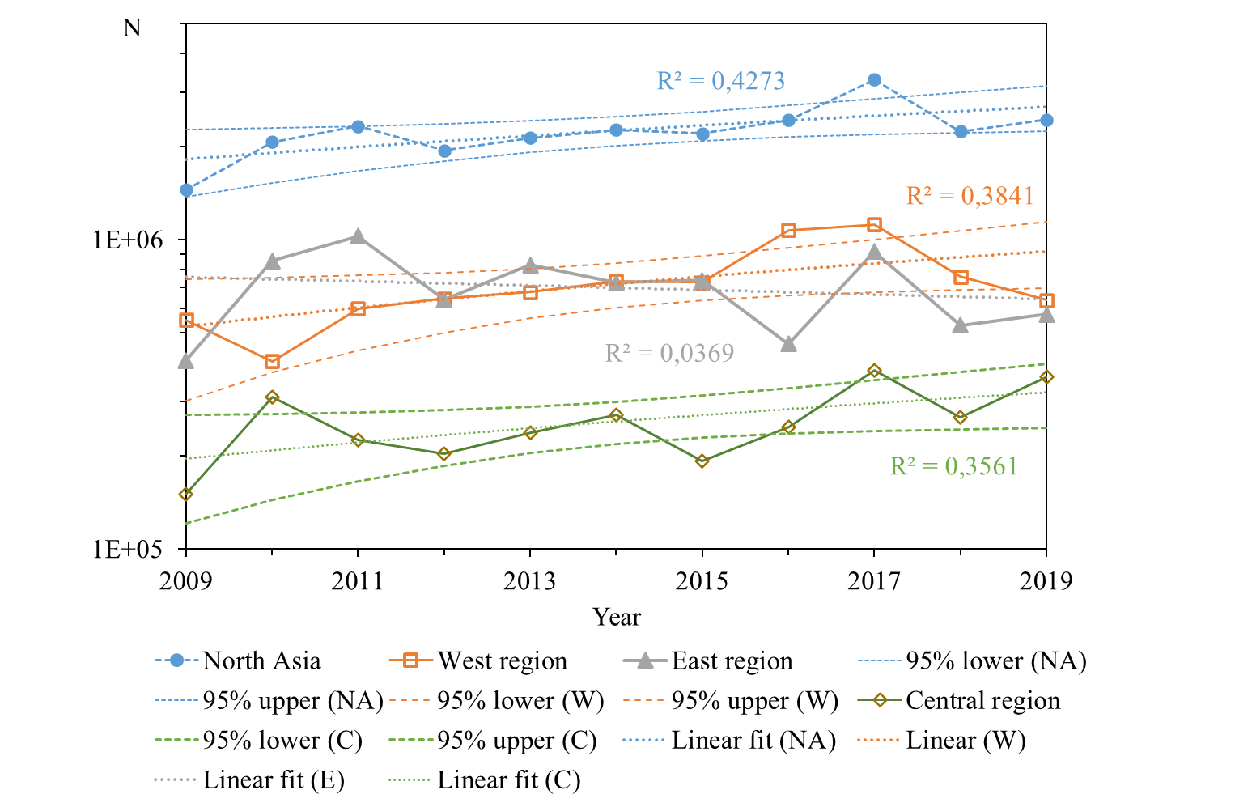
Annual total lightning stroke number

Slide 5
Seasonal variations

Slide 6
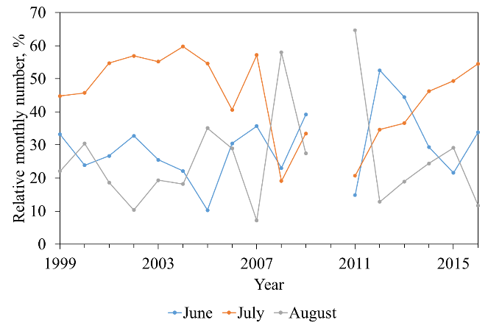
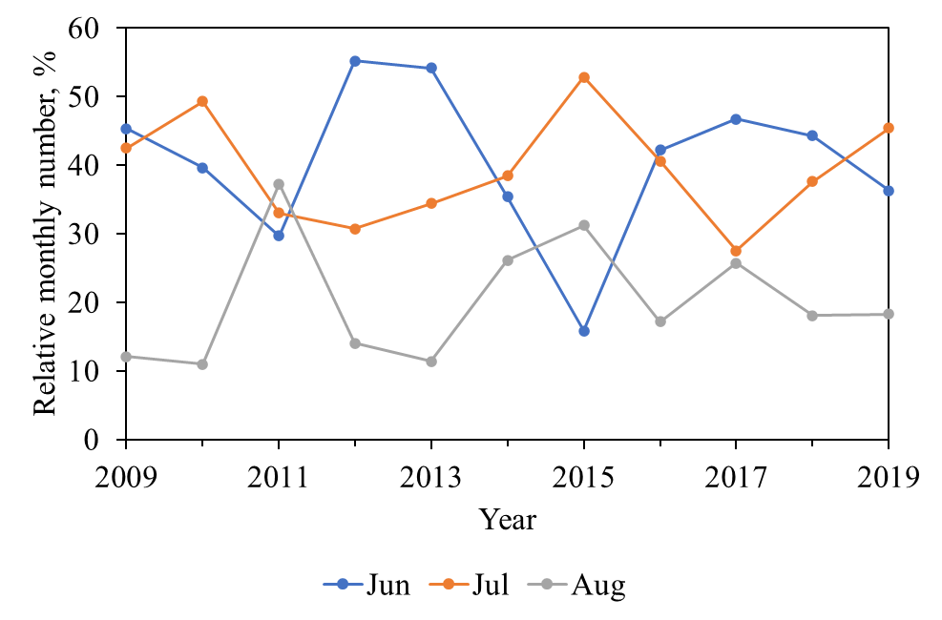
Ratio of monthly number to the total summer number
Yakutia
Figure - Relative monthly number by the data of (a) lightning direction finder (1200 km around Yakutsk), (b) WWLLN (56–74 N, 105–160 E).

Slide 7
Spectrum - FFT
Western region
Period (day) | Frequency (day⁻¹) | Amplitude
29,9 | 0,0335 | 346,2
17,7 | 0,0566 | 307,3
14,9 | 0,0672 | 365,9
7,6 | 0,1313 | 244,6
5 | 0,1995 | 148,7
3,8 | 0,2622 | 185,5
Western region
Central region
Eastern region
Period (day) | Frequency (day⁻¹) | Amplitude
26,09 | 0,038 | 298,2
19,7 | 0,051 | 114,4
17,1 | 0,058 | 125,2
13,65 | 0,073 | 77,3
9,2 | 0,108 | 112
7,9 | 0,126 | 115,2
6,1 | 0,164 | 74,82
5,5 | 0,183 | 54,1
4,4 | 0,225 | 85,93
Period (day) | Frequency (day⁻¹) | Amplitude
29,05 | 0,034 | 298,2
16,93 | 0,059 | 204,9
14,58 | 0,0686 | 263,9
9,55 | 0,105 | 220,9
7,94 | 0,126 | 150,2
7,3 | 0,137 | 193,5
6,32 | 0,158 | 189,9
4,41 | 0,227 | 271,2
Eastern region
Central region

Slide 8
Continuous wavelet transform (discrete Meyer wavelet)
T, days
47.6
24.4
12
6

Slide 9
Analytical expression
2009-2017
Observed mean lightning density
Adapted expression of annual lightning density:
$$P(φ,λ)=A(λ)\exp\left(−{\left(\frac{φ−B\left(λ\right)}{C\left(λ\right)}\right)}^{2}\right)−0,03φ+2,2$$
Derived lightning density
$$A(λ,t)=\sum_{n=1}^{2}{a_{n}(t)\exp\left(−{\left(\frac{λ−b_{n}}{\left.c_{n}(t\right)}\right)}^{2}\right)}$$
$$B\left(λ\right)=−0,1∗λ+64,6$$
or
$$B\left(λ\right)=−0,1∗λ+63,7+10,9∗\exp\left(−{\left(\frac{λ−112,8}{9,7}\right)}^{2}\right)−10,9∗exp\left(−{\left(\frac{λ−117,9}{10,3}\right)}^{2}\right)$$
$$C\left(λ\right)=8,2∗\exp\left(−{\left(\frac{λ−76,8}{22,9}\right)}^{2}\right)+11,5∗\exp\left(−{\left(\frac{λ−115,9}{11,3}\right)}^{2}\right)+18,4∗\exp\left(−{\left(\frac{λ−168,1}{30,3}\right)}^{2}\right)$$

Slide 10
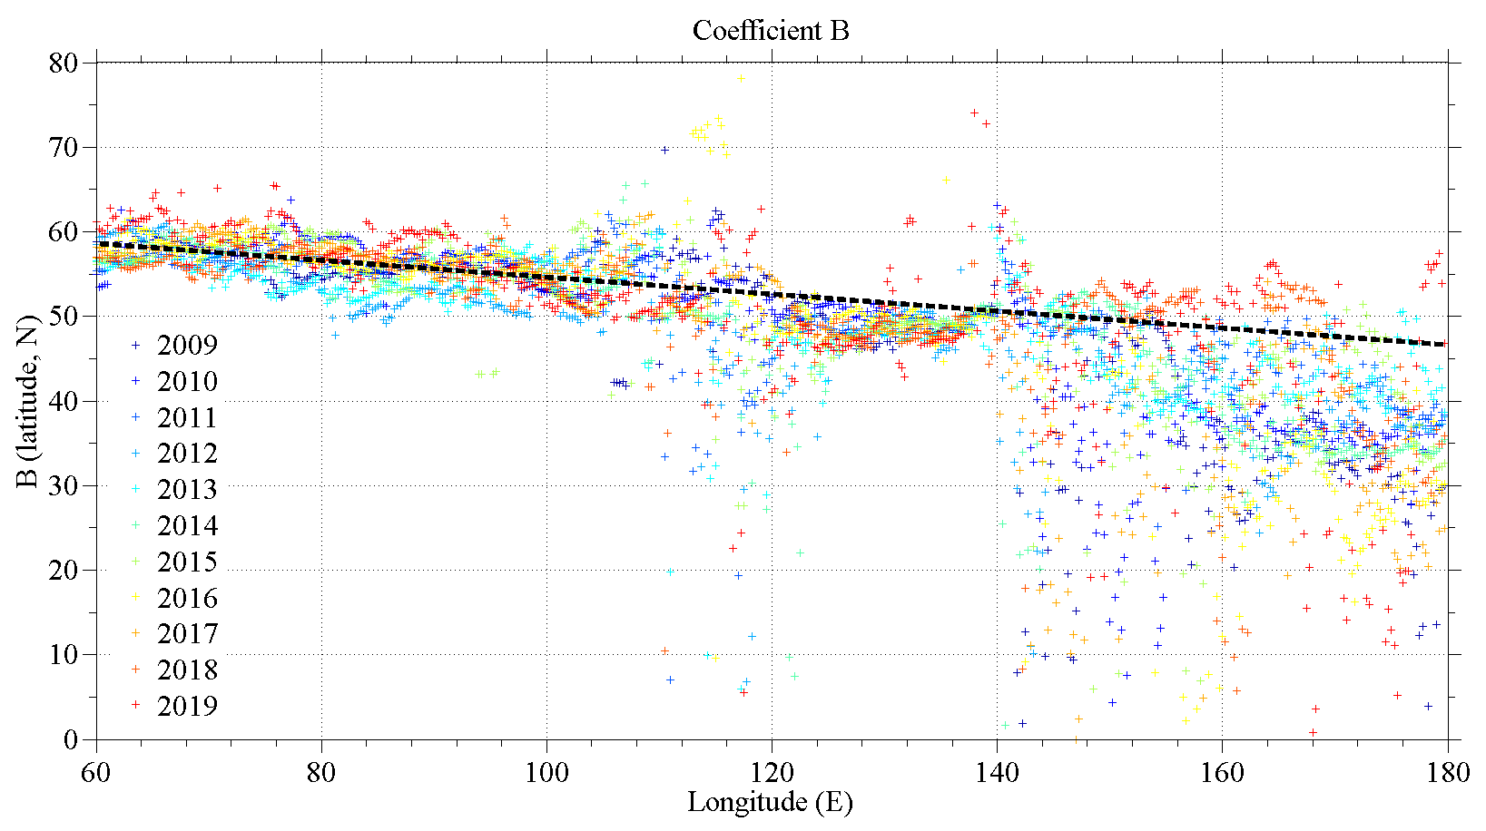
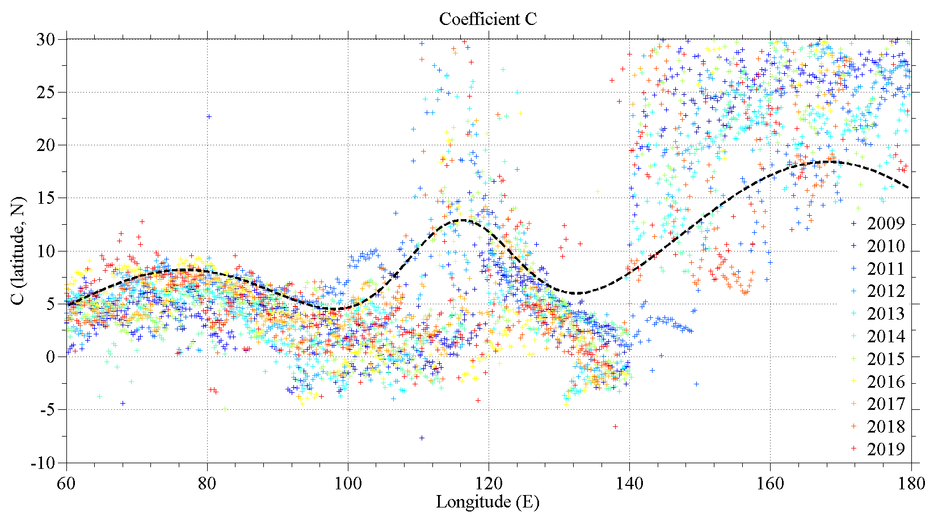

Slide 11
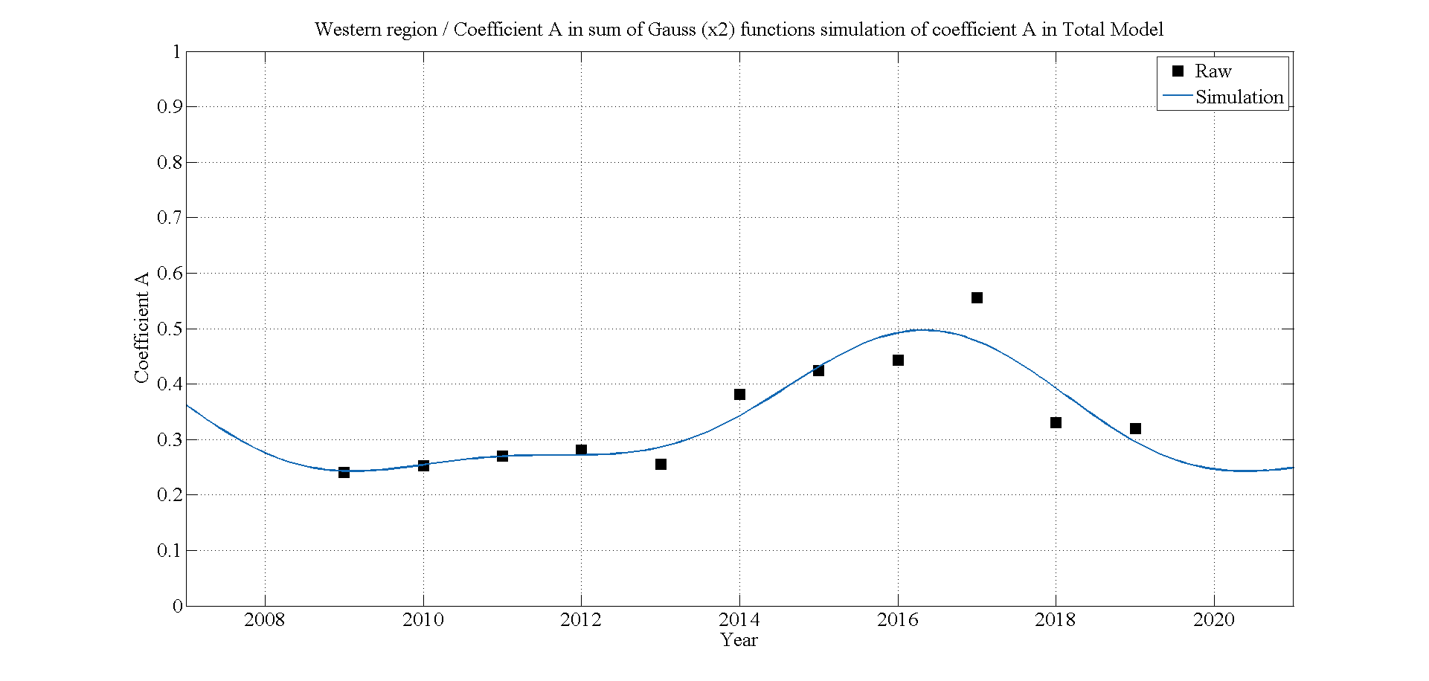
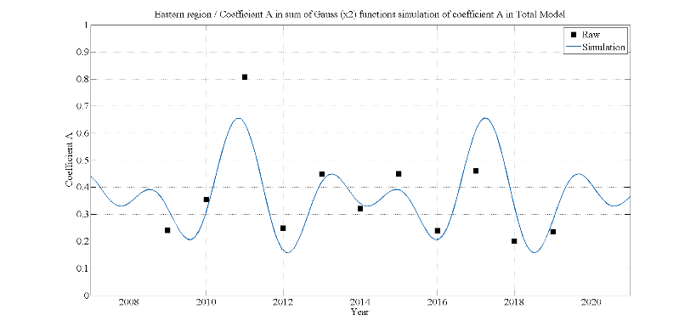
Coefficients of peak density
$$A(λ,t)=\sum_{n=1}^{2}{a_{n}(t)\exp\left(−{\left(\frac{λ−b_{n}(t)}{\left.c_{n}(t\right)}\right)}^{2}\right)}$$
$$a_{n}\left(t\right)=α_{0}+\sum_{k=1}^{2−3}{\left(α_{k}\cos\left(kωt\right)+β_{k}sin{(}kωt)\right)}$$
$a_{n}(t)$ – variation of peak density in western (~ 70 E) and eastern (~ 129 E) regions:
Western region: α0 = 0.34, α1 = -0.06, β1 = -0.1, α2 = -0.03, β2 = 0.03, w = 0.56, (11.2 years) R²= 0.84;
Eastern region: α0 = 0.37, α1 = 0.04, β1 = -0.01, α2 = 0.12, β2 = 0.04, α3 = 0.07, β3 = 0.09, w = 0.98 (6.4 years), R²= 0.7;
a) western region
b) eastern region

Slide 12
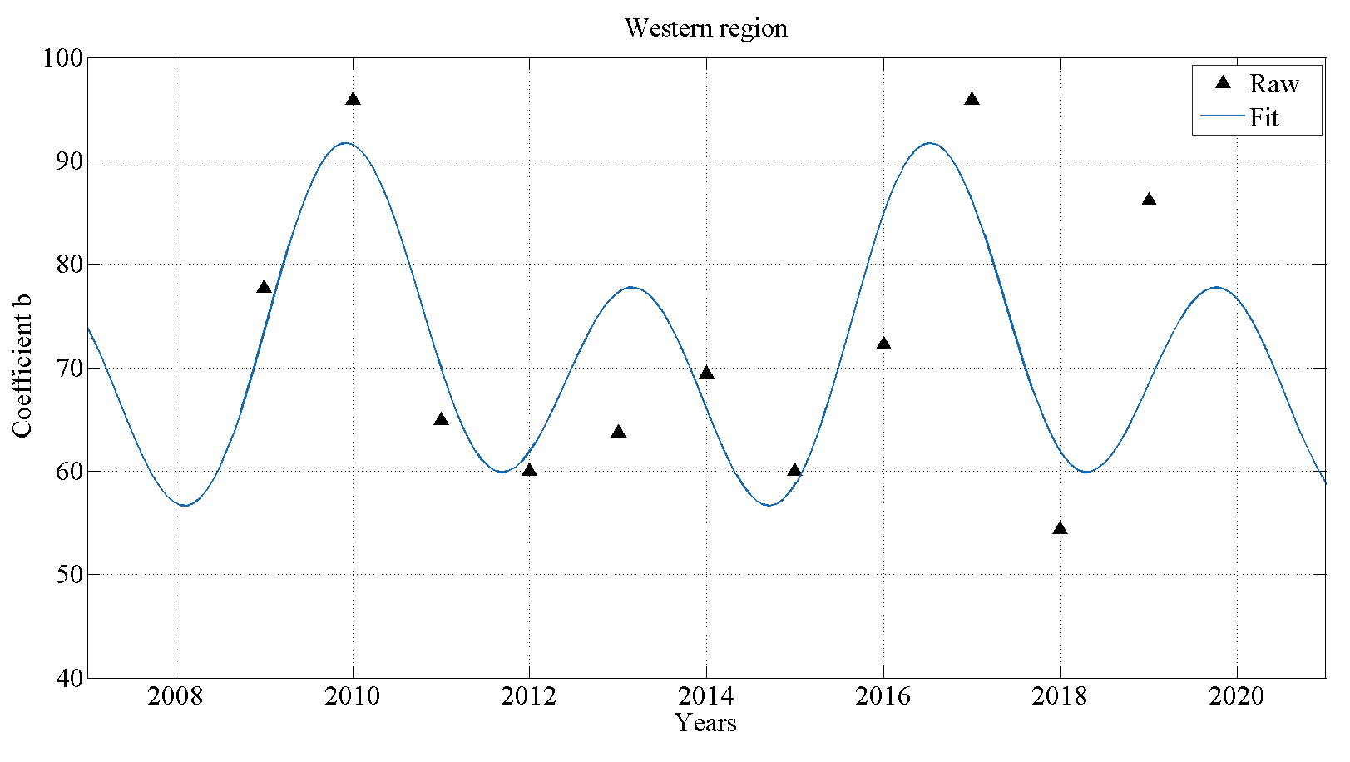
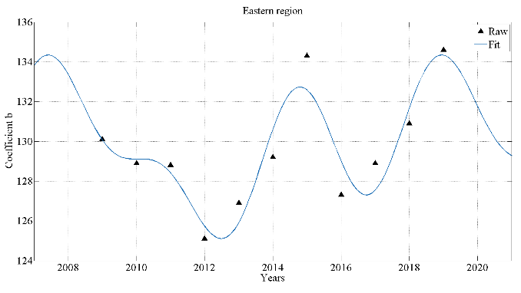
$b_{n}(t)$ – displacement of the longitude of peak density to the west and the east:
Western region: α0 = 71.71, α1 = -3.46, β1 = 6.29, α2 = -11.12, β2 = -6.72, w = 0.95 (6.6 years), R²=0.56;
Eastern region: α0 = 129.7, α1 = 2.2, β1 = -0.32, α2 = -0.12, β2 = 2, α3 = 2, β3 = 0.38, w = 0.54 (11.6 yr.), R²= 0.85;
a) western region
b) eastern region

Slide 13
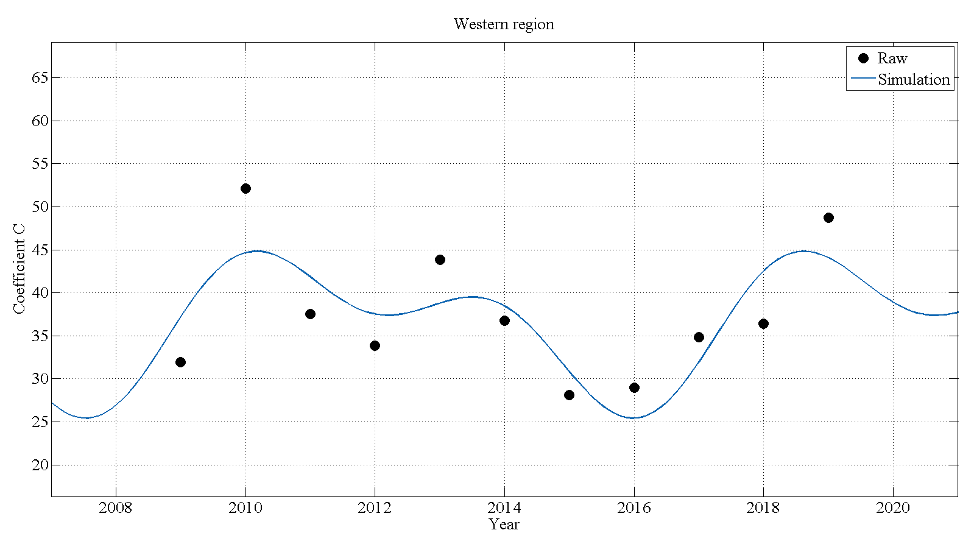
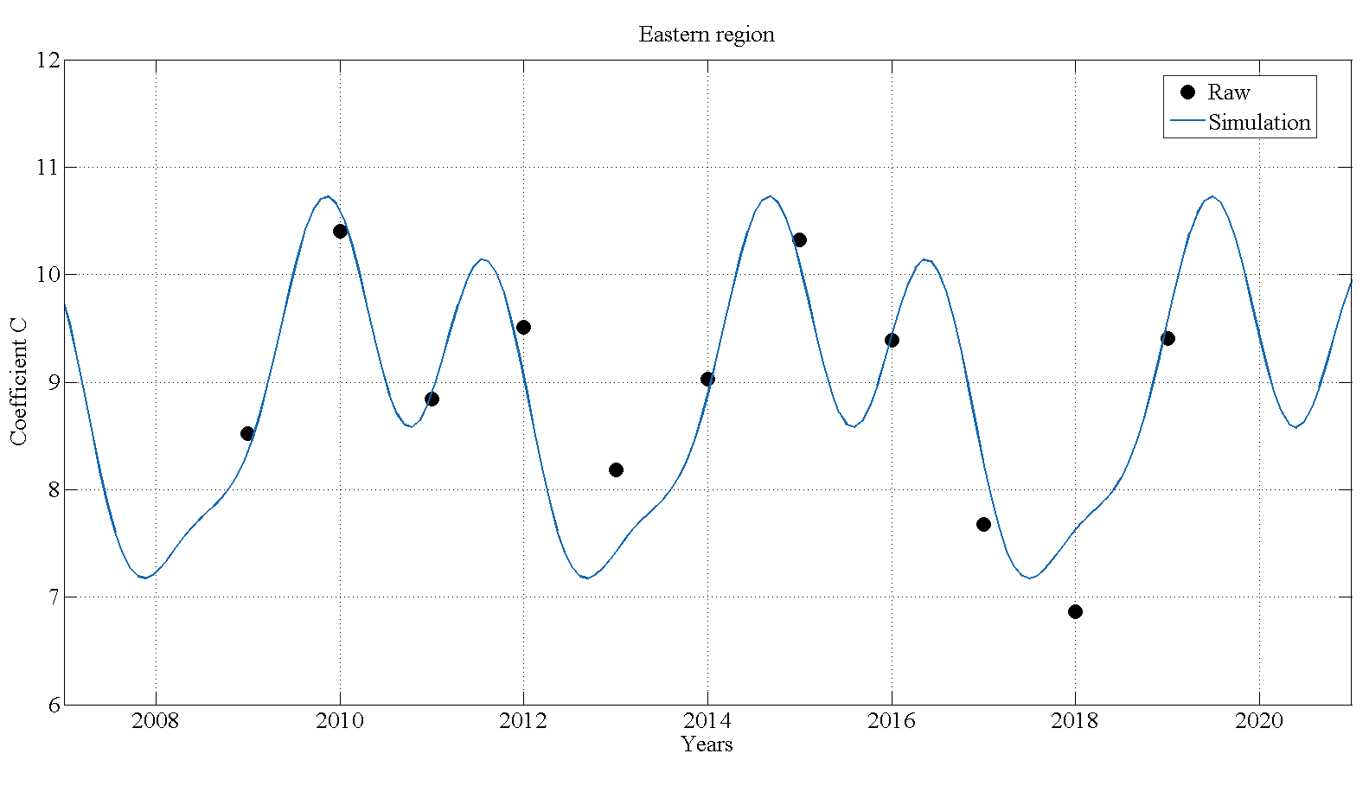
$c_{n}(t)$ – dispersion of peak density
Western region: α0 = 36.39, α1 = 6.1, β1 = 2.7, α2 = 0.65, β2 = -4.73, w = 0.74 (8.5 years), R²=0.61;
Eastern region: α0 = 8.9, α1 = -0.18, β1 = -1.15, α2 = 0.78, β2 = 0.26, α3 = 0.41, β3 = -0.41, w = 1.31 (4.8 yr.), R²= 0.84;
a) western region
b) eastern region

Slide 14
Conclusion
The discrete decomposition of the series (of daily resolution) using the discreet Meyer wavelet function to fifth level (eastern) and forth level (western) showed a shift in the maximum of seasonal variation in the regions from the beginning of June to beginning of August from year to year with a period of about 3 years.
The periodicity in the seasonal variations of lightning number obtained by the Fourier spectra appeared in the western region more clearly: 4, 7, 14, 17 days.
The spatial distribution of lightning density in North Asia can be described as a belt around 50 N with a more than 5 degrees latitude shift to the south in the east with significant peaks in density especially in two regions. The analytical expression is suggested in the form of a latitudinal Gaussian function varying with longitude summarized with a linear function as the background decline to the north of the general lightning activity level. The parameters included in the Gaussian function are represented by the density dependence on longitude. The latitude position parameter is sufficiently approximated by the linear longitude function, and the latitudinal distribution broadening parameter is the sum of three Gaussian functions. The parameter responsible for the description of the density peak is defined by the sum of two Gaussian functions, and their coefficients depends on the year as the sum of Fourier series with two or three harmonics.

Slide 15
Thank you for attention!

