Slide 1
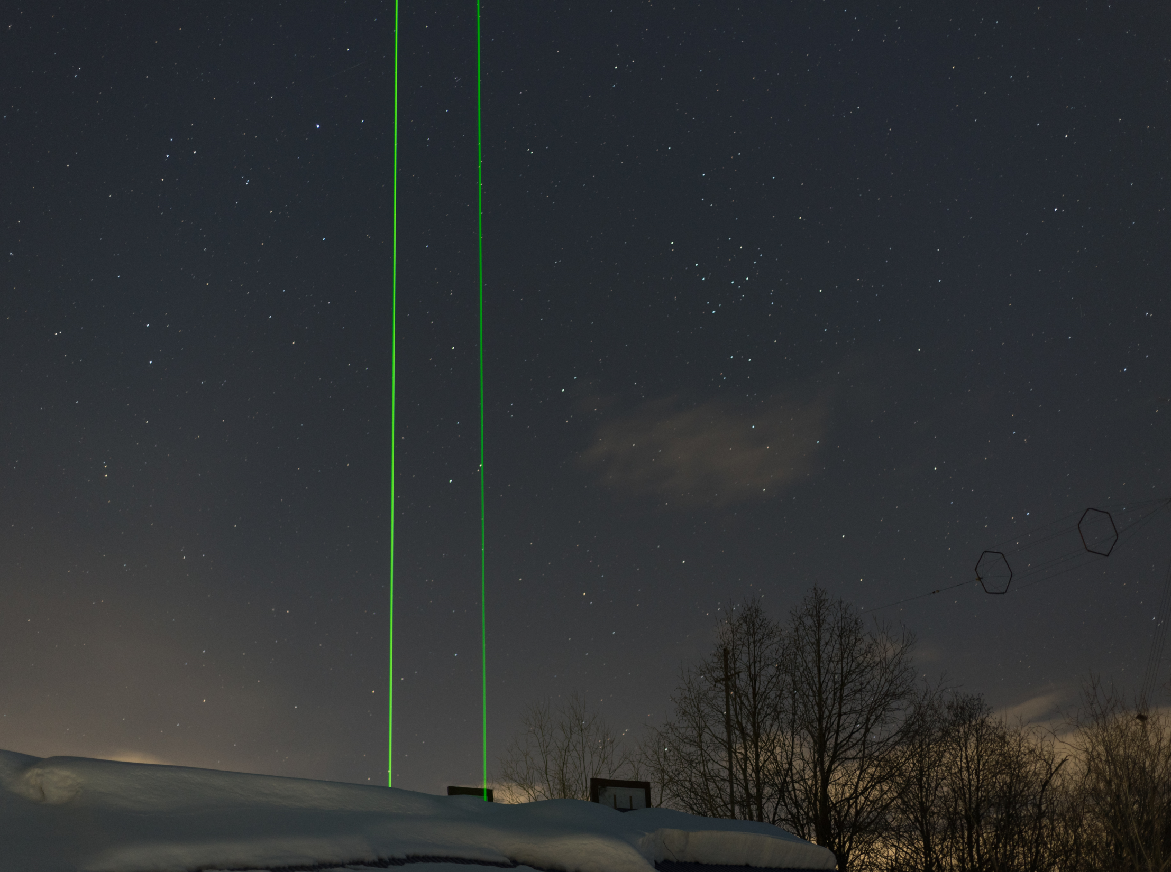
Thermospheric lidar
Resonant reflections, observations and applications
Results of the 15 years
B.M. Shevtsov
IKIR FEB RAS
Notes:
Резонансные отражения, наблюдения и приложения. Итоги 15 летнего проекта.

Slide 2
Thermospheric lidar is designed to determine the components of the upper atmosphere.
In the laser ionosonde mode, the lidar can be used as a charged particle precipitation detector.
Based on the results of optical sounding along long paths, the transparency of the atmosphere is determined.
This value is important for astronomical observations, optical communications, weather and climate changes.
Heat, dry thunderstorms and forest fires are also a consequence of the high transparency of the atmosphere.
Thermospheric lidar reflections can be considered as indicators of high transparency of the atmosphere and a dangerous state of the environment.
Notes:
Но прежде чем рассмотреть лидарные отражения,

Slide 3
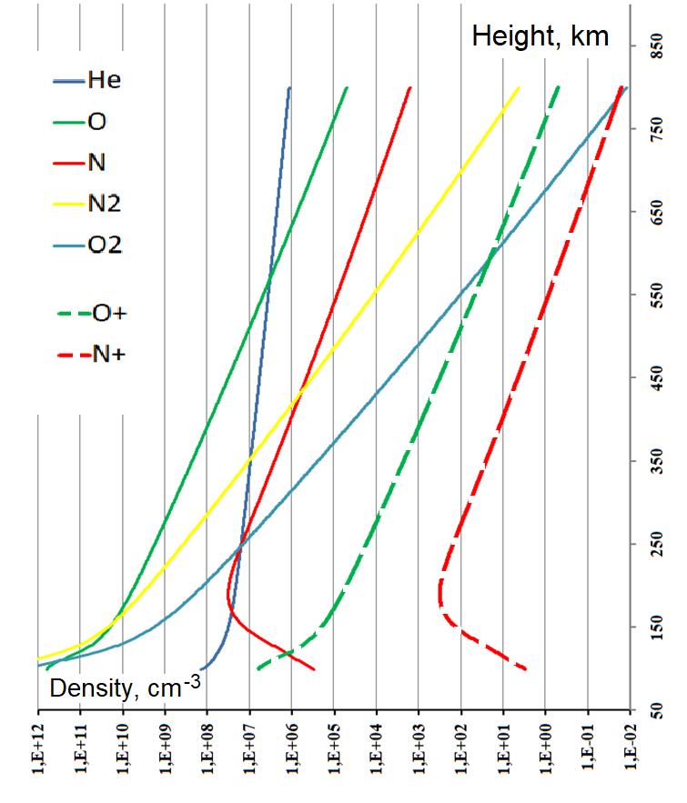
Thermosphere
International Reference Ionosphere Model, January
Operating heights of TS lidars
N2⁺ Lidar, Alaska University
He Lidar, Illinois University
O+ and N+ Lidar,
Laser ionosonde,
Kamchatka, IKIR FEB RAS,
2008, 2017
Metal vapors

Slide 4
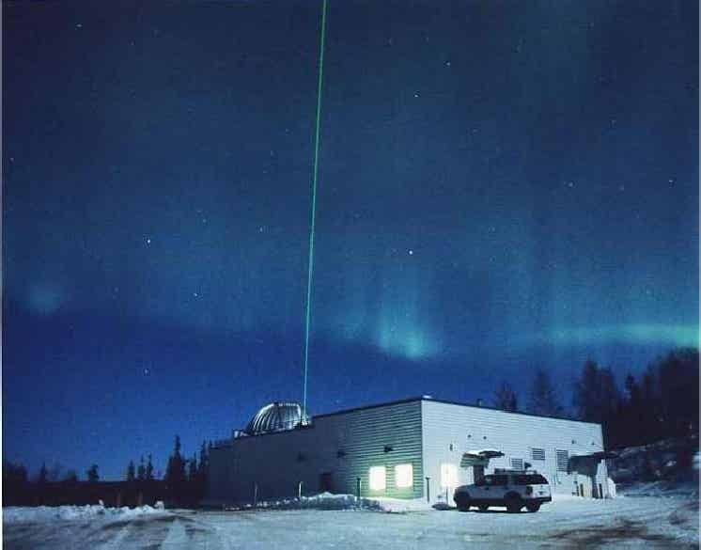
University of Alaska, Fairbanks

Slide 5
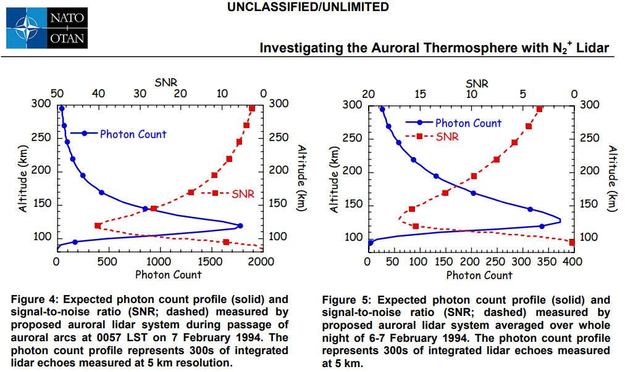
Collins R.L., Su L., Lummerzheim D., Doe R.A. (2006) Investigating the Auroral Thermosphere with N2+ Lidar. In: Characterising the Ionosphere (РР. 2-1 – 2-14). Meeting Proceedings RTO-MP-IST-056, Paper 2. Neuilly-sur-Seine, France: RTO Available from: http://www.rto.nato.int/abstracts.asp.
Observations are expected from 2006.

Slide 8
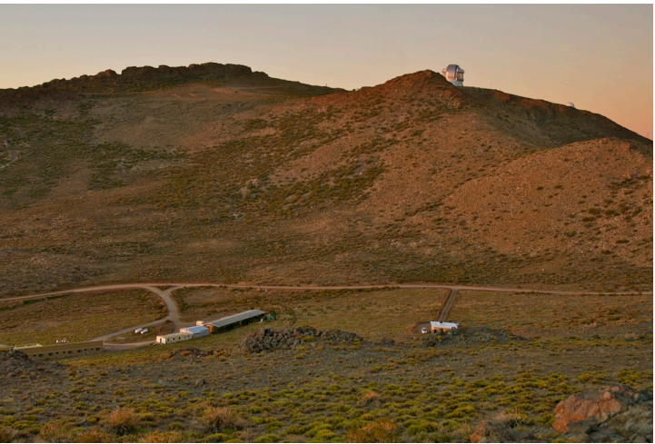
Observatory at Arecibo

Slide 9
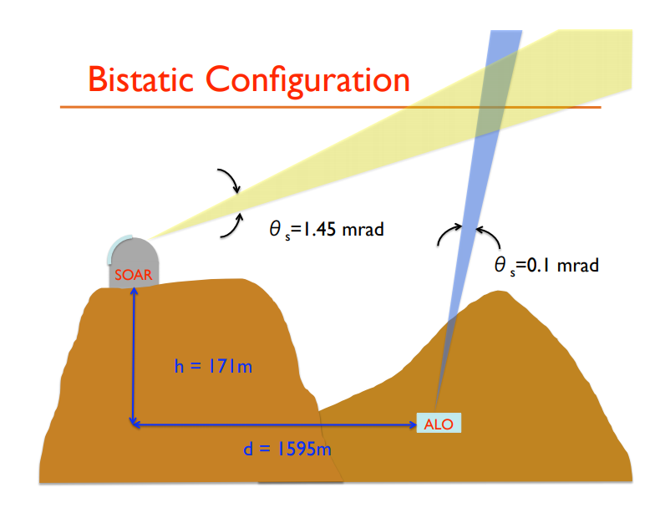

Slide 10
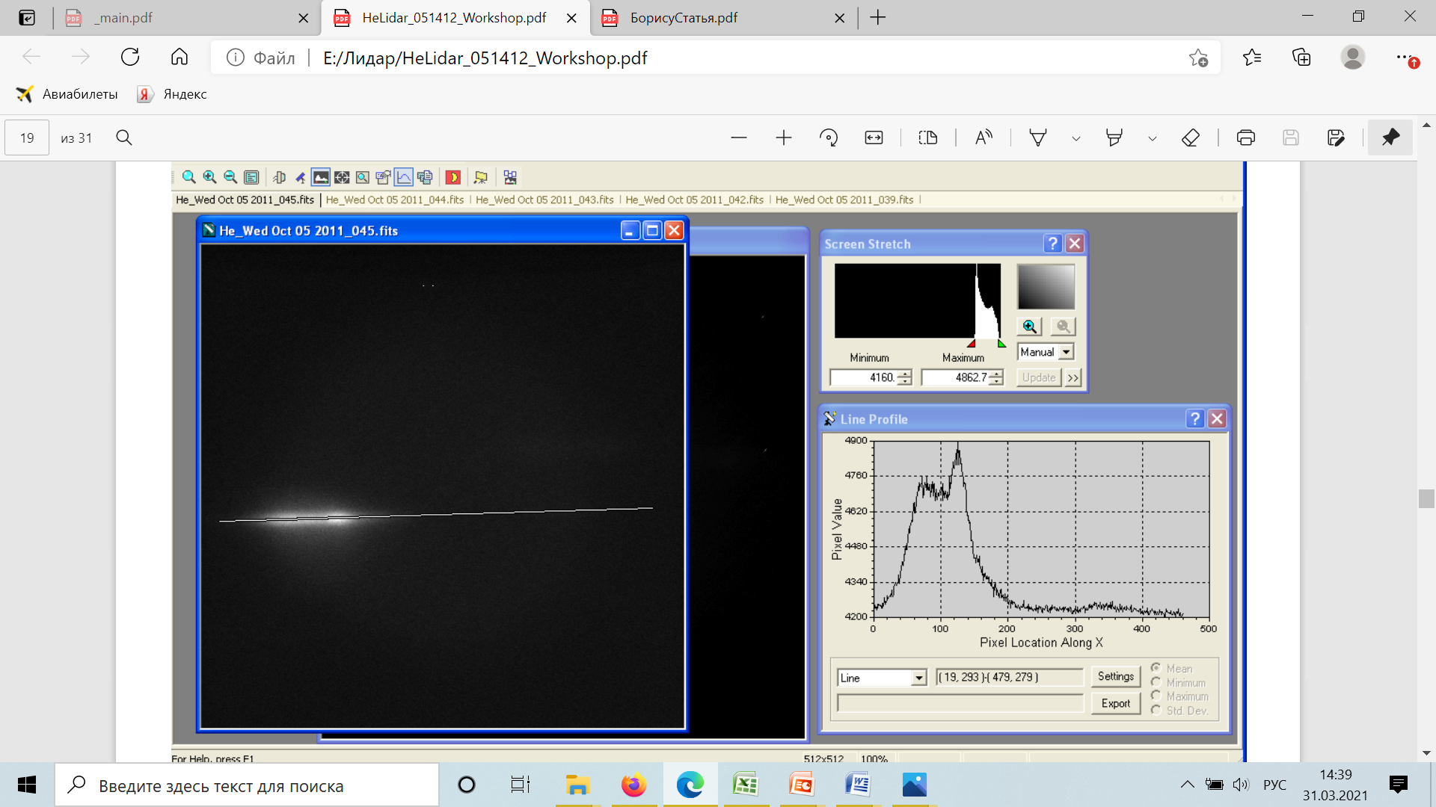
Thermospheric He Lidar for He 1083 nm

Slide 11
Waldrop, L. S., R. B. Kerr, S. A. Gonzalez, M. P. Sulzer, J. Noto, and F. Kamalabadi. Generation of metastable helium and the 1083nm emission in the upper thermosphere. J. Geophys. Res., 110(A08304), 2005.
Observations are expected from 2005.

Slide 12
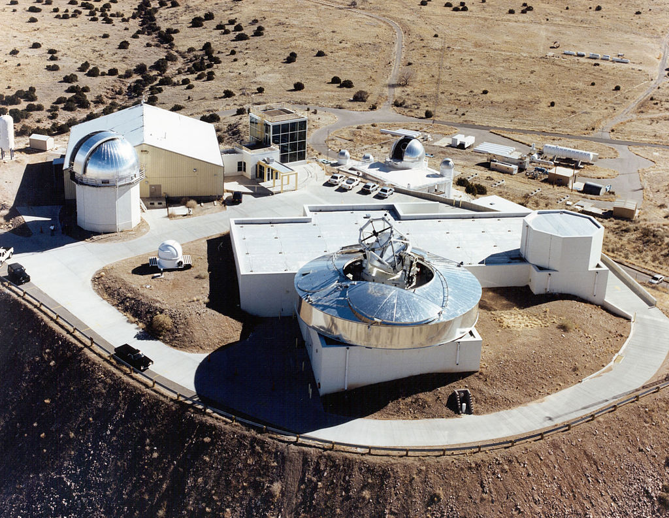
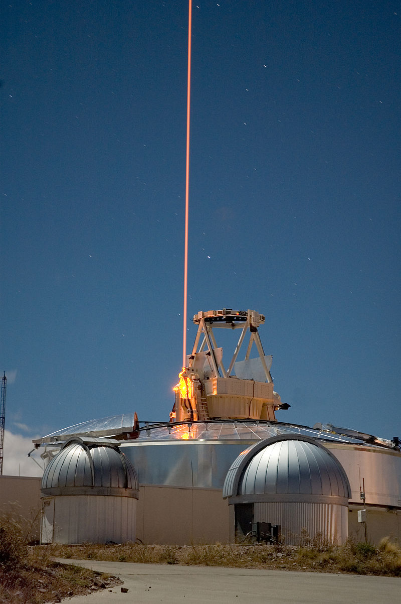
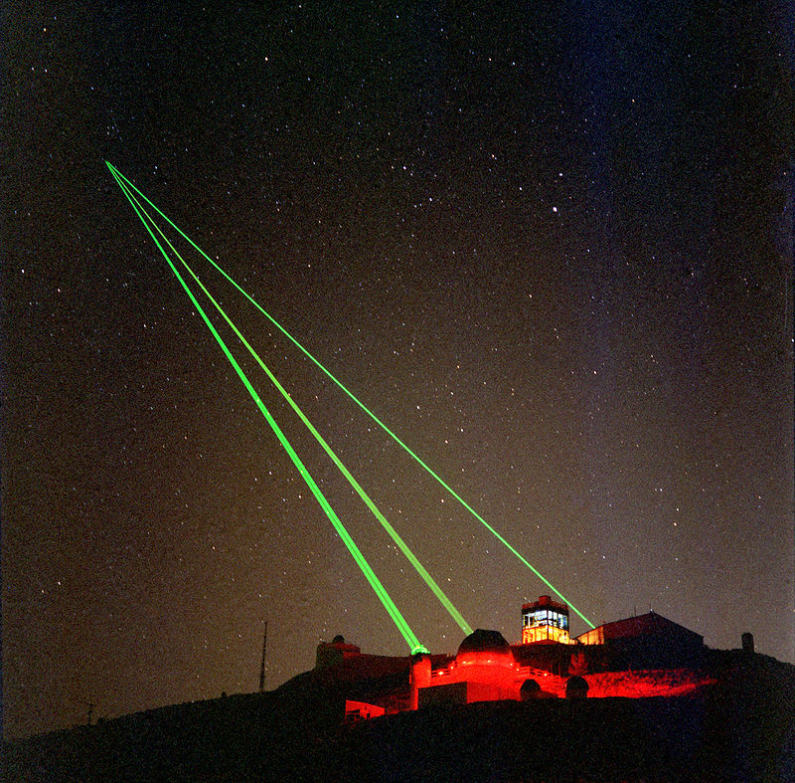
Starfire Optical Range
SOR's optical equipment includes a 3.5 meter telescope which is "one of the largest telescopes in the world equipped with adaptive optics designed for satellite tracking" according to the Air Force, a 1.5 meter telescope, and a 1-meter beam director.
Notes:
SOR's optical equipment includes a 3.5 meter telescope which is "one of the largest telescopes in the world equipped with adaptive optics designed for satellite tracking" according to the Air Force, a 1.5 meter telescope, and a 1-meter beam director.

Slide 13
IKIR FEB RAS, Kamchatka

Slide 14
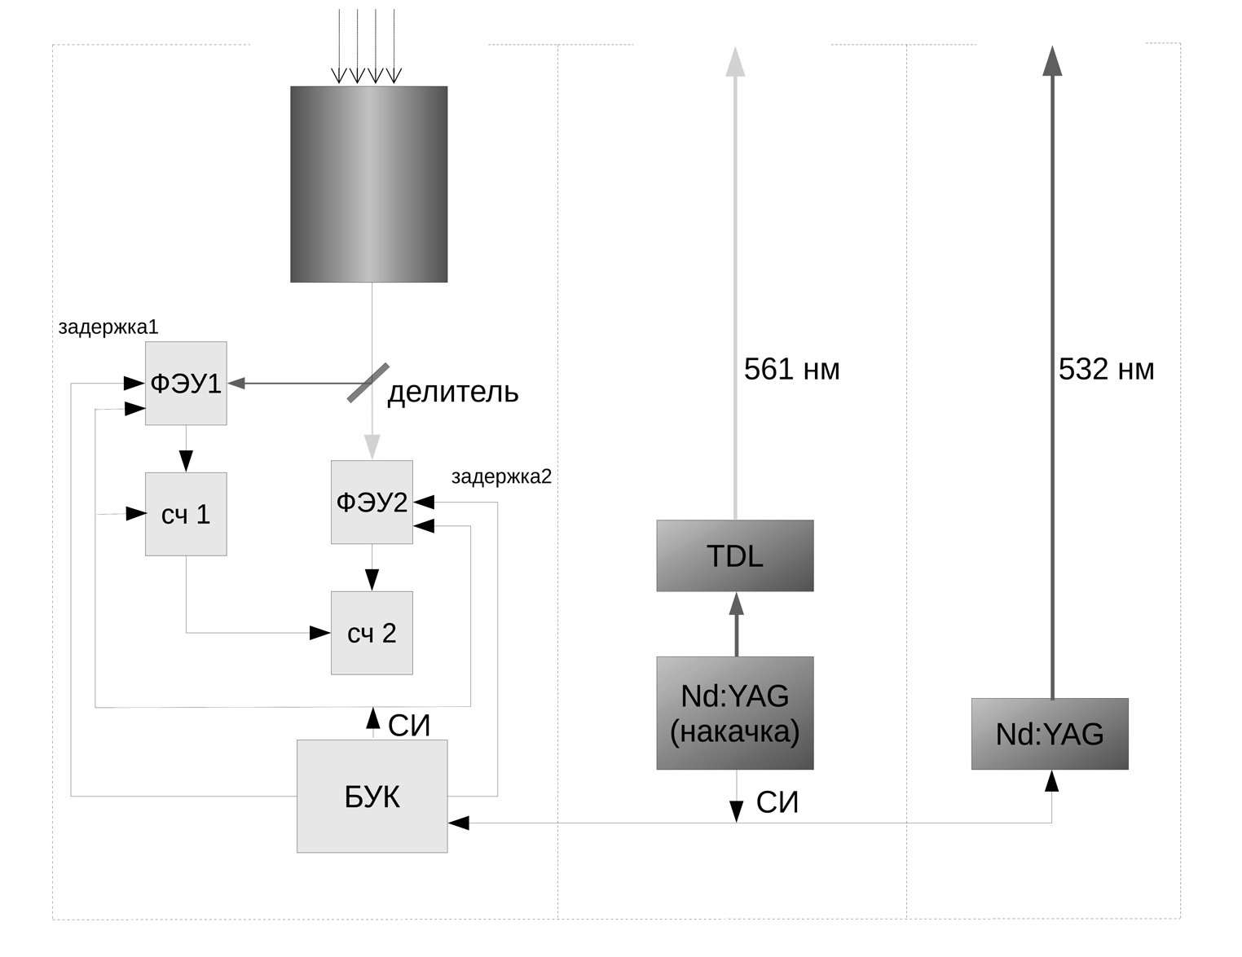
Receiver
Second transmitter
First transmitter
Telescope

Slide 15
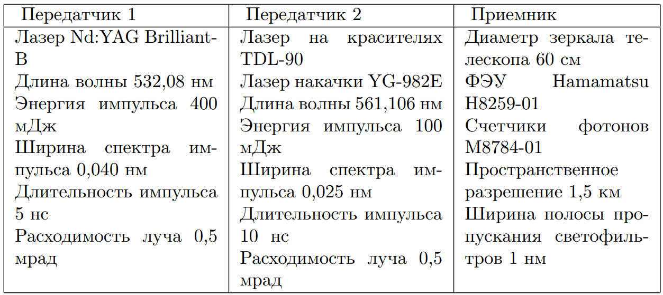
First transmitter
Second transmitter
Receiver
2006 г.
2015 г.

Slide 16
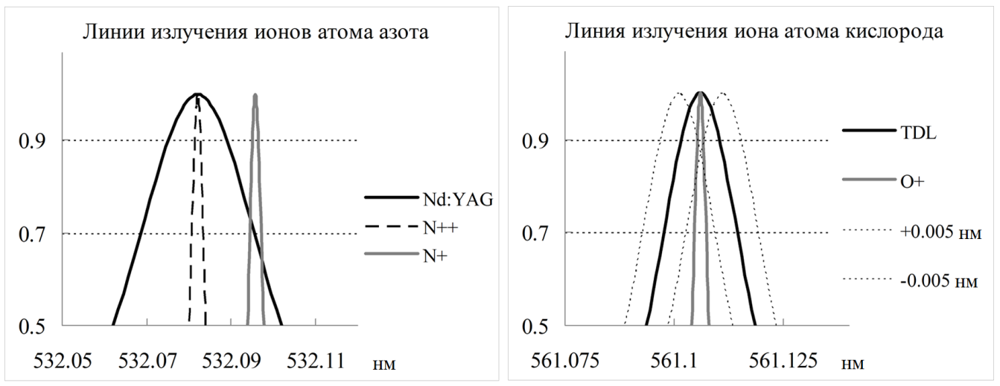
2014 and 2017
Dipole transitions of excited ions of oxygen and nitrogen atoms

Slide 17
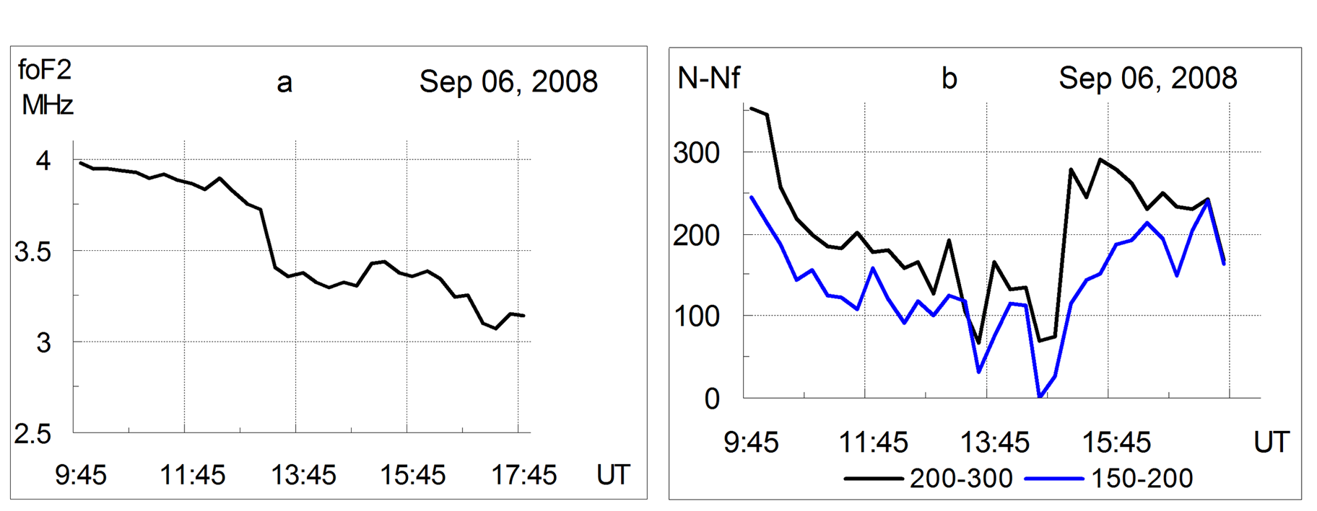
Results on 6 September 2008
Critical frequency foF2 of the ionospheric F2 layer (a)
lidar signals summed for altitudes 150–200 and 200–300 km (b).

Slide 18
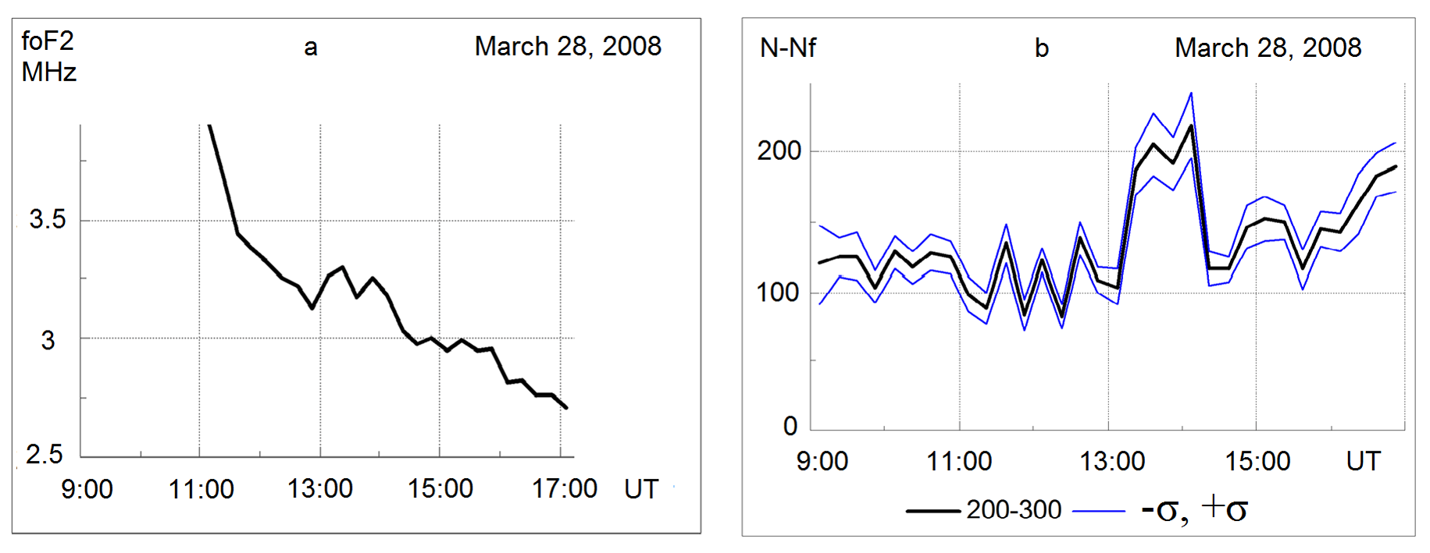
Results of observations on 28 March 2008 (Bychkov and Shevtsov 2012)
Critical frequency foF2 of the ionosphere F2 layer (a);
lidar signal N–Nf summed for altitudes 200-300 km representing the total number of detected photons minus the background level (b).
The middle curve shows the average signal, the upper and lower curves illustrate the standard deviations.
The accumulation of lidar signal is 15 minutes.

Slide 19
Luminescence specters of the night sky on February, 28th 2012 due to precipitations from the radiation belts have a great variability
There was a quiet magnetic condition.
All K-indexes were equaled 1.
Intensity
wavelength, nm
Intensity
wavelength, nm

Slide 20
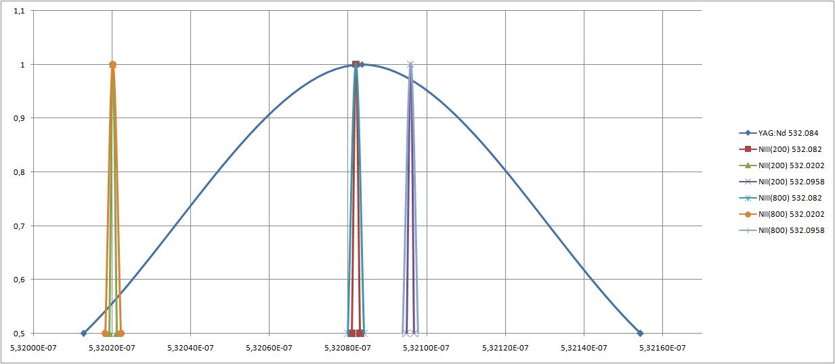
Spectral lines of the nitrogen atom ions transitions lie within the band of second harmonic of the Nd: YAG laser 532.08 ± 0.07 nm
EPS, 2014 г.
Example of spectral lines of atomic transitions from Catalog NIST ASD, 1978
 |  | Wavelength in Air (nm) | A_{ki} (s⁻¹) | Lower Level | Term | J | Upper Level | Term | J
1 | NII | 532.0202 | 4.20e+07 | 2s2p²(⁴P)3p | ⁵P° | 2 | 2s2p²(⁴P)3d | ⁵P | 1
2 | NIII | 532.087 | 5.68e+07 | 2s2p(³P°)3p | ²D | 5/2 | 2s2p(³P°)3d | ²F° | 7 /2
3 | NII | 532.0958 | 2.52e+07 | 2s2p²(⁴P)3p | ⁵P° | 1 | 2s2p²(⁴P)3d | ⁵P | 2
The scattering of laser radiation with a wavelength of 532 nm in the upper atmosphere is caused by excited nitrogen ions.
1
2
3
The density of N⁺ exceeds that of N⁺⁺ at altitudes 200–300 km

Slide 21
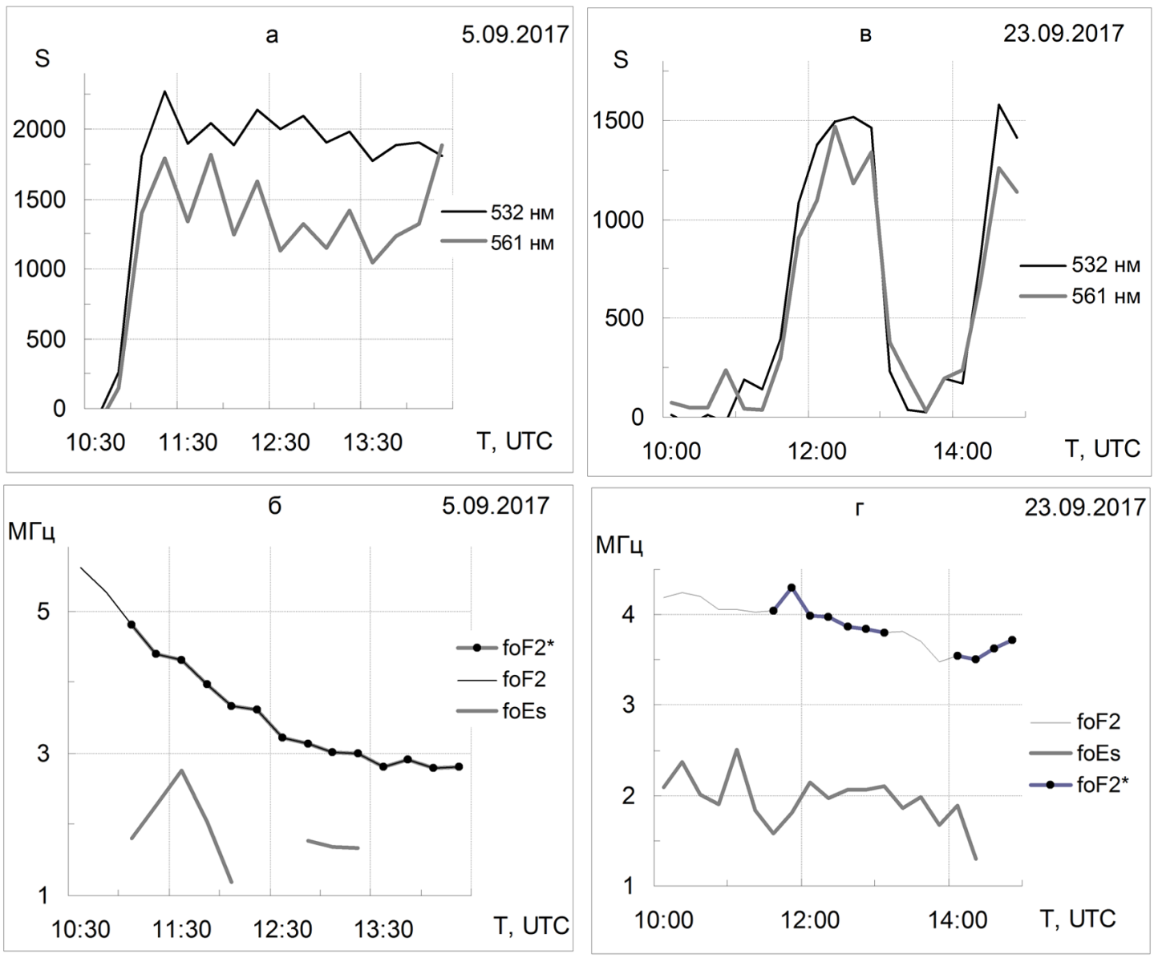
Effect of the thermosphere
Impact of a neutral atmosphere
Lidar signal summed over a layer of 200-400 km (top) and 𝑓𝑜𝐹2 and 𝑓𝑜𝐸𝑠 (bottom).

Slide 22
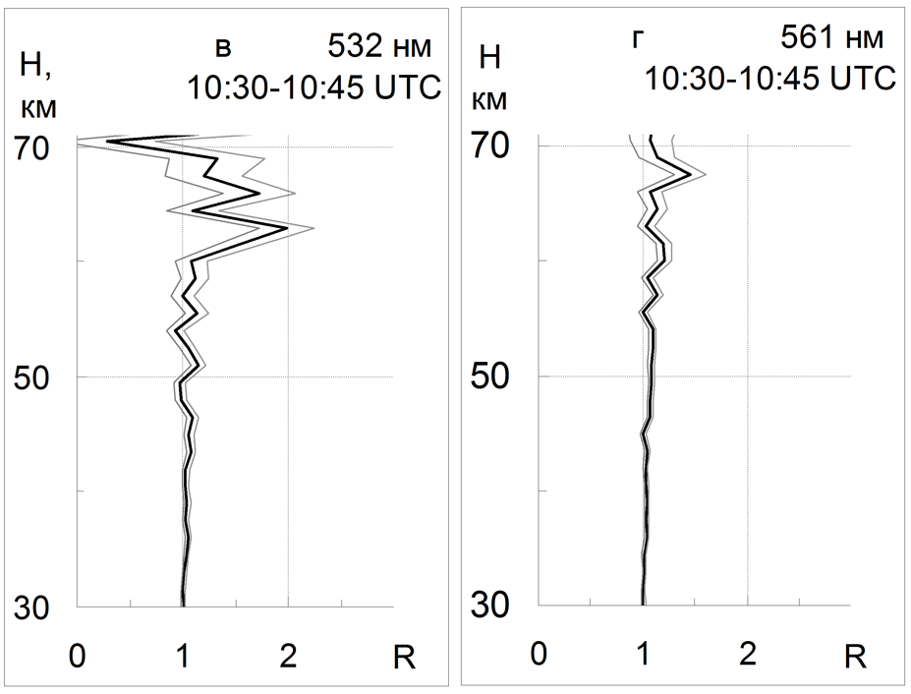
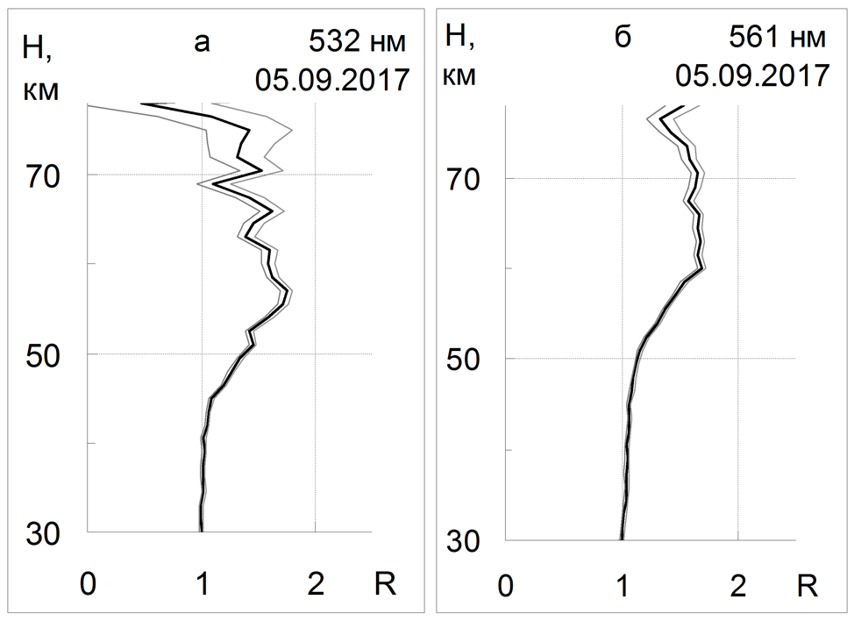
Lidar signal of the middle atmosphere

Slide 23
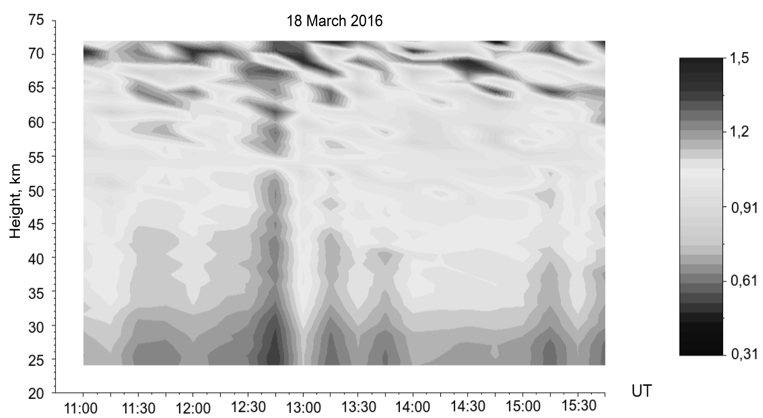
Transparency windows in the middle atmosphere

Slide 24
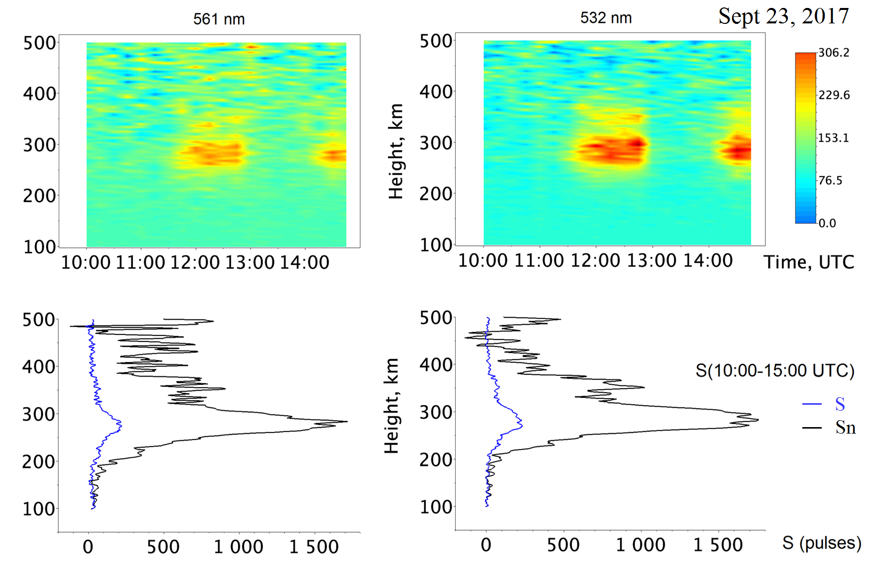
Form of signals

Slide 25
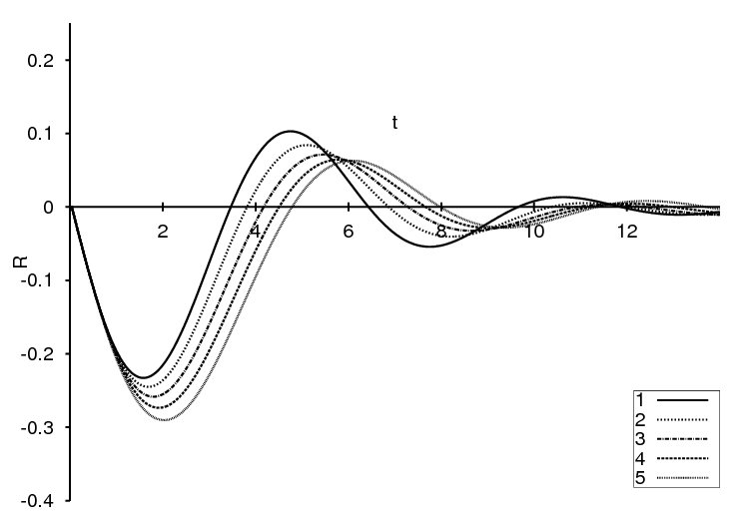
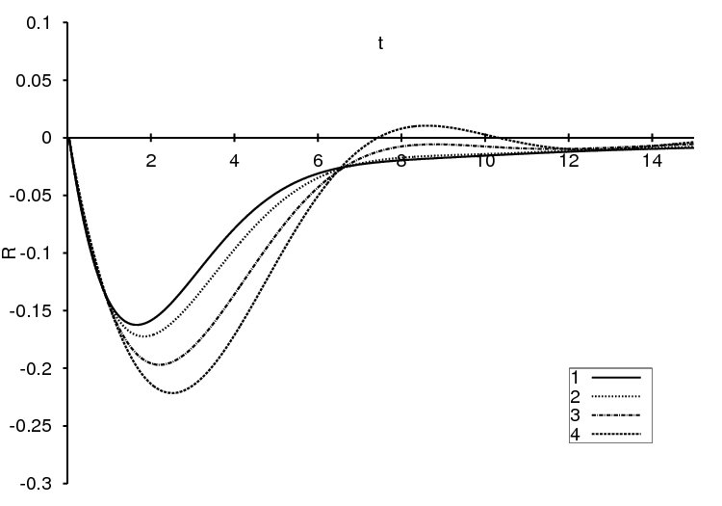
Explanation of lidar observations / EPS, 2014 г.
Resonant reflection theory / РиЭ, 2014 г.
Reflections in the case of fractional
relaxation in plasma
Reflections in the case of fractional
oscillations

Slide 26
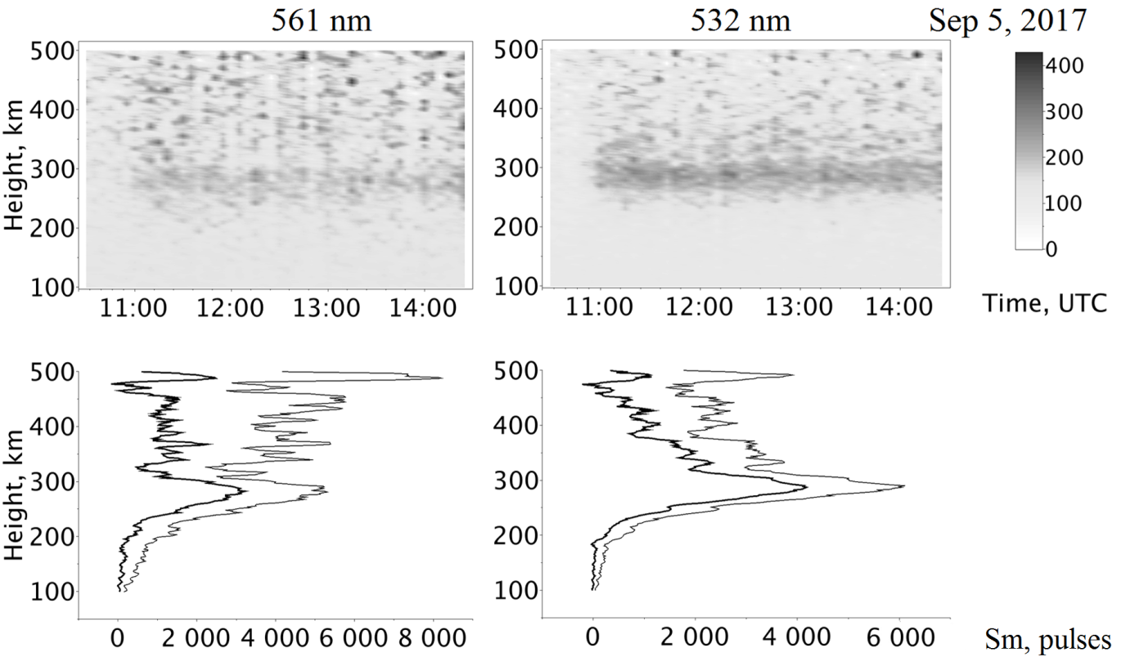
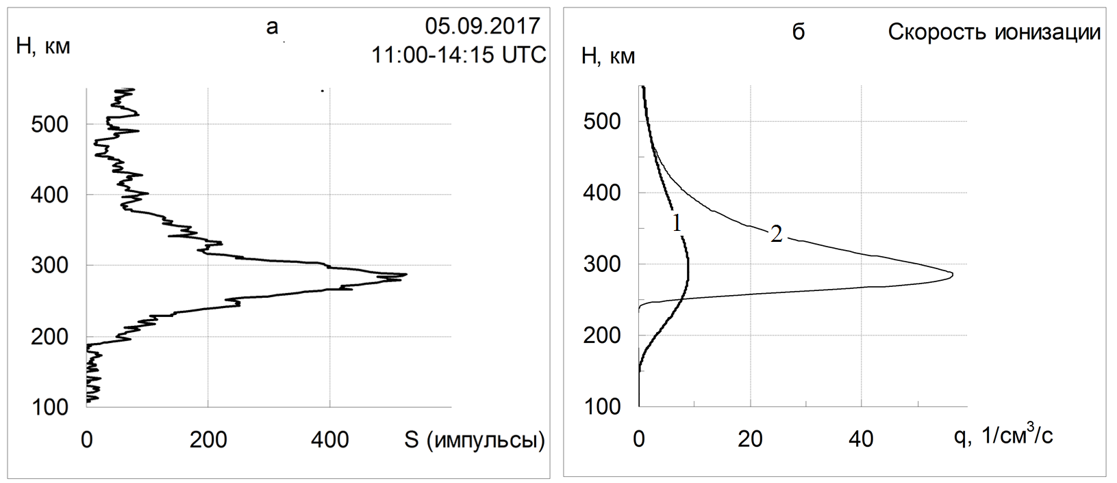
Alternative for explaining reflections
Precipitation Charged Particle Signal Model

Slide 27
Collins R.L., Su L., Lummerzheim D., Doe R.A. (2006) Investigating the Auroral Thermosphere with N2+ Lidar. In: Characterising the Ionosphere (РР. 2-1 – 2-14). Meeting Proceedings RTO-MP-IST-056, Paper 2. Neuilly-sur-Seine, France: RTO Available from: http://www.rto.nato.int/abstracts.asp.
Observations are expected from 2006.

Slide 28
Waldrop, L. S., R. B. Kerr, S. A. Gonzalez, M. P. Sulzer, J. Noto, and F. Kamalabadi. Generation of metastable helium and the 1083nm emission in the upper thermosphere. J. Geophys. Res., 110(A08304), 2005.
Observations are expected from 2005.

Slide 29
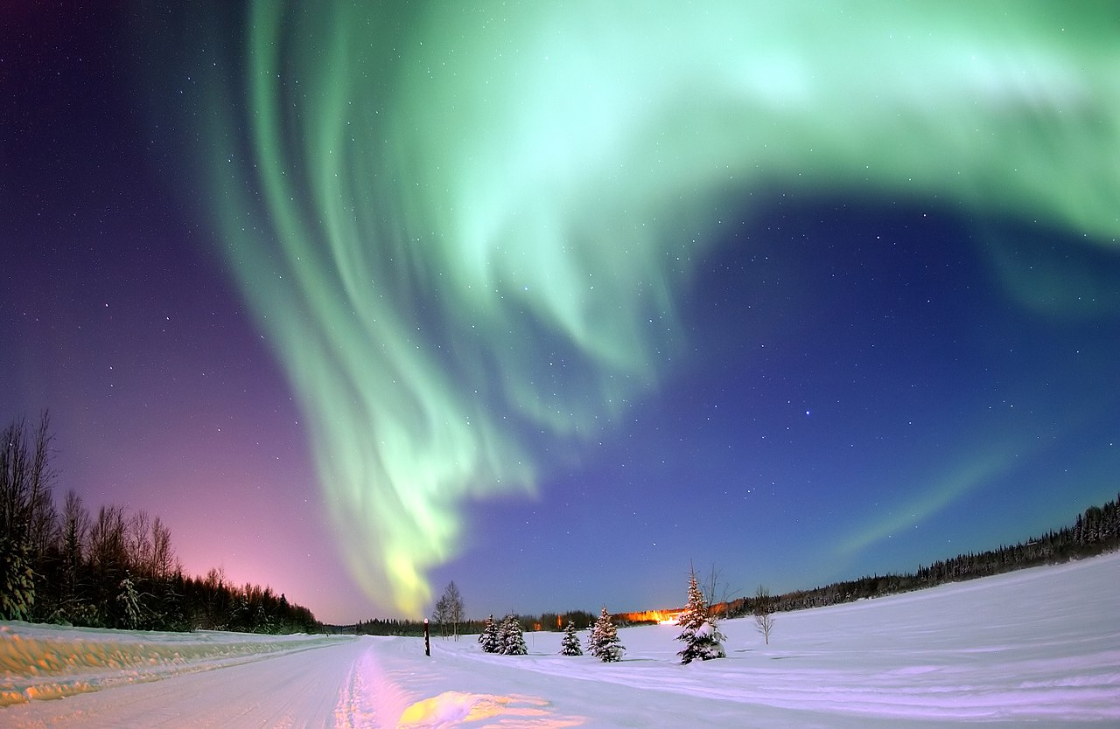
Lidar observations of precipitates in the Arctic thermosphere
The number of working days in the Arctic is 2%.
The number of working days in Kamchatka is 20%.

Slide 30
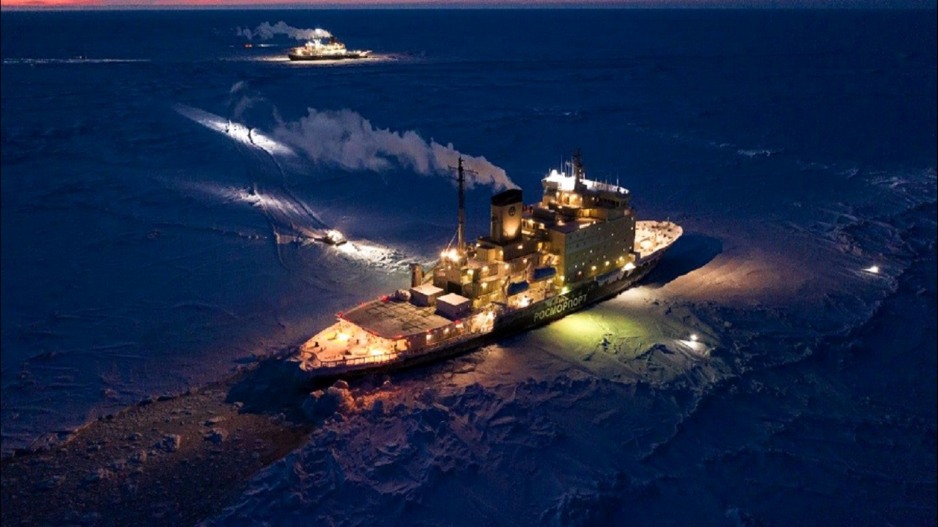
Ship lidar

Slide 31
Lidar observations from a stratospheric plane

Slide 32
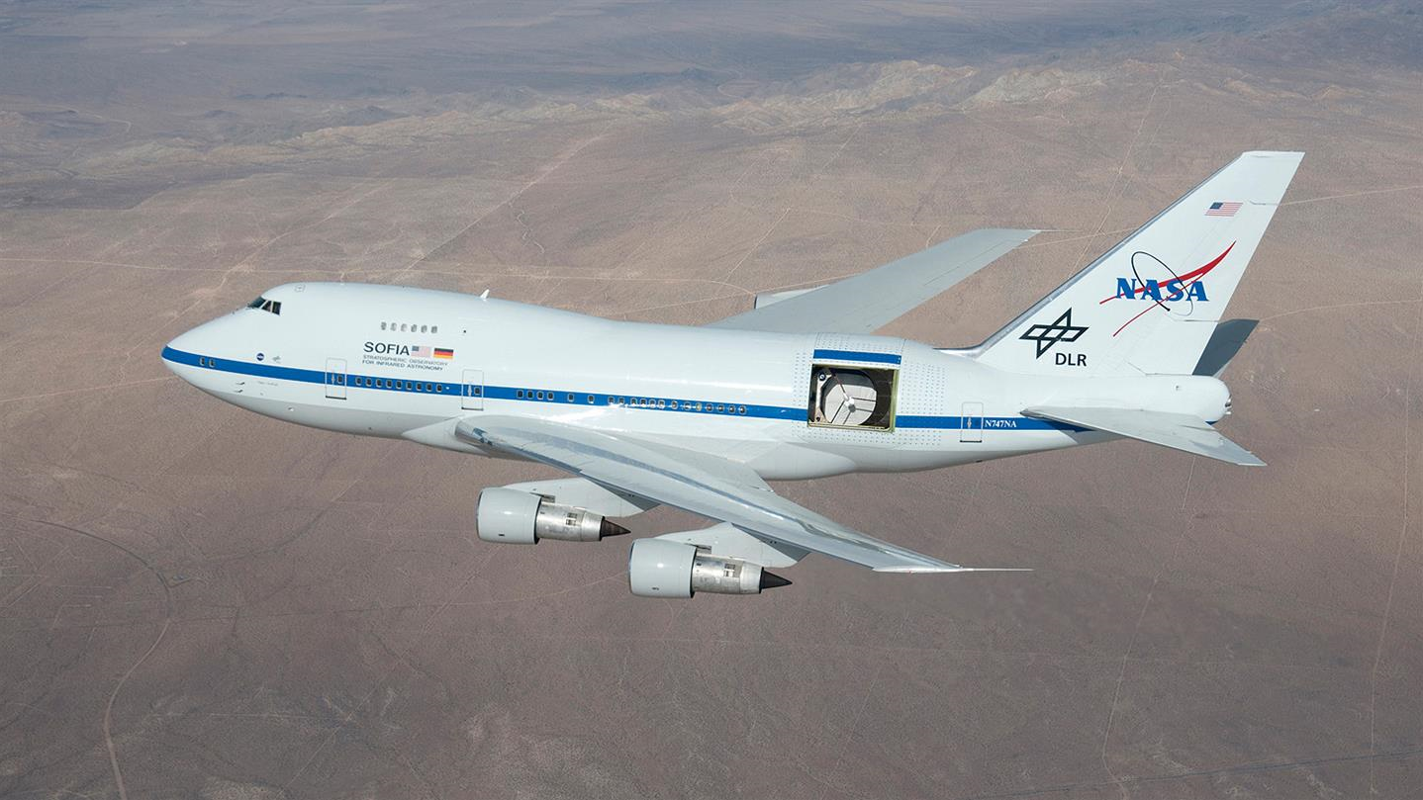
SOFIA

Slide 33
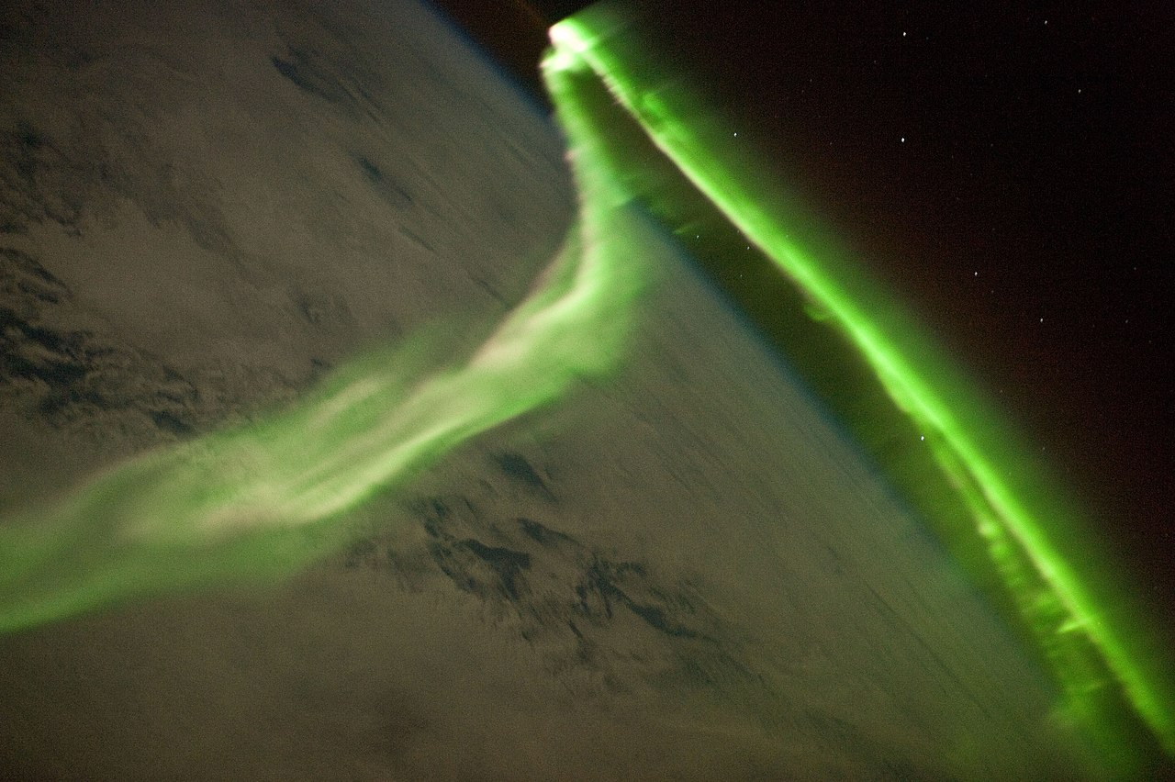
Aurora from the ISS
The travel time of the satellite through the aurora region about some minutes is short for the accumulation of the sounding signal, but we will be in the aurora region and there will be no influence of the atmosphere.

Slide 34
Recombination effect
Kinetic equation dn⁺/dt = bn – an⁺n⁻
Conditions dn⁺/dt = 0 and n⁺ = n⁻ give
bn – an⁺ n⁻ = 0 и n⁺ = (bn/a)^{1/2}.
The quantities b and a must be determined.
Recombination affects the width of the ion resonance line.

Slide 35
Conclusion
Multifrequency thermospheric lidar is created.
Resonant reflection problem is solved.
The high efficiency of selective reflections in the thermosphere is shown.
A modification of the properties of resonance scattering was found with changes in the concentration of the components of the medium.
A Lidar complex for observations in the range of heights from 0 to 500 km has been created, which can also be used for studies of atmospheric transparency.

Slide 36
Current problems
Fluctuation effects in resonant thermospheric reflections.
Resonant refraction in the thermosphere.
Influence of solar activity on climate change through the modification of the properties of the thermosphere.
Ionization effects in the middle atmosphere.
Regular observations of changes in atmospheric transparency in the altitude range from 0 to 500 km.
Comparative analysis of the transparency of different layers of the atmosphere.

