Slide 1
RESULTS OF PHYSICAL MODELING OF THE RESPONSE OF THE THE ATMOSPHERIC POTENTIAL GRADIENT TO THE PASSAGE OF ERUPTIVE CLOUDS FROM THE EXPLOSIONS OF THE EBEKO VOLCANO (PARAMUSHIR ISLAND).
Akbashev R.R., Firstov P.P.
Kamchatka branch Geophysical Survey of the Russian Academy of Science
Petropavlovsk-Kamchatsky, 2021

Slide 2
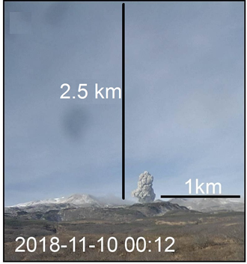
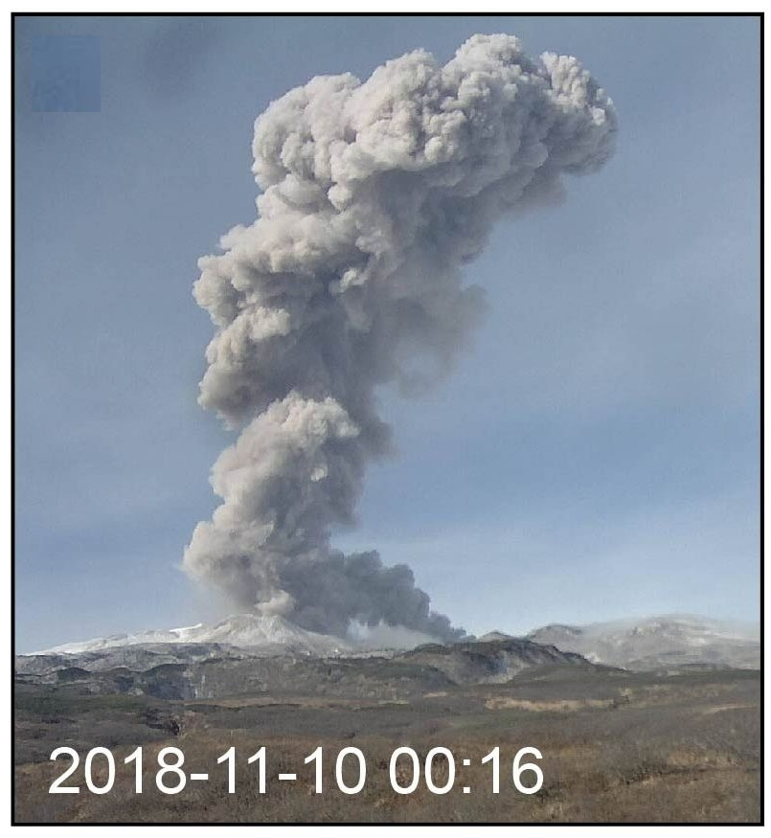
Introduction
Ebeko volcano is located on Paramushir Island. It is one of the most active volcanoes of the Kuril Island Arc. The duration of eruptions is 2-4 years. The type of eruptions is explosive (volcanic type).
The volcanic cloud (VC) rises to heights of 2-4 km above sea level. VC is a complex volumetric electrostatic structure that continuously changes over time. The carriers of charges in VC are ash, aerosols.
Studies of the electrification of the VC of the Ebeko volcano have been conducted since 2018 based on the registration of the atmospheric electric potential gradient (PG) in the city of Severo-Kurilsk (SKR).

Slide 3
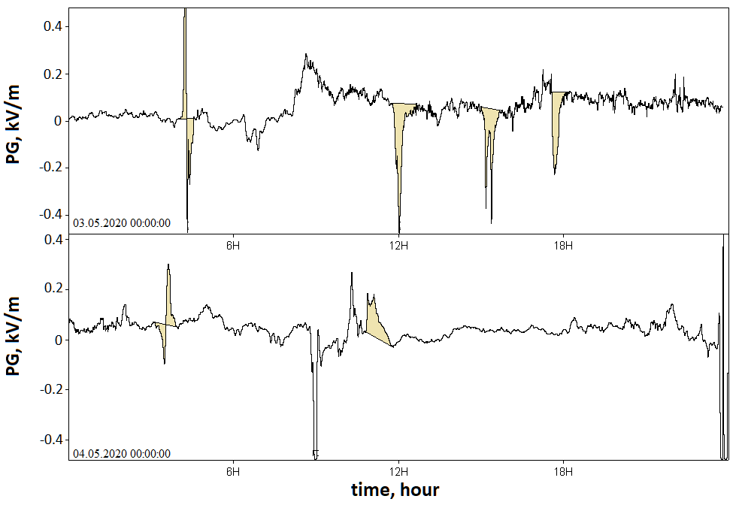
Examples of PG responses from VC registered in SKR
Since 2018, a large amount of experimental material has been accumulated: negative, positive, dipole variations of the PG response.
To explain the sets of PG responses on the Ebeko volcano in the period from 29.07.2020 to 05.08.2020, PG observations were made in the near zone from the crater of the volcano.

Slide 4
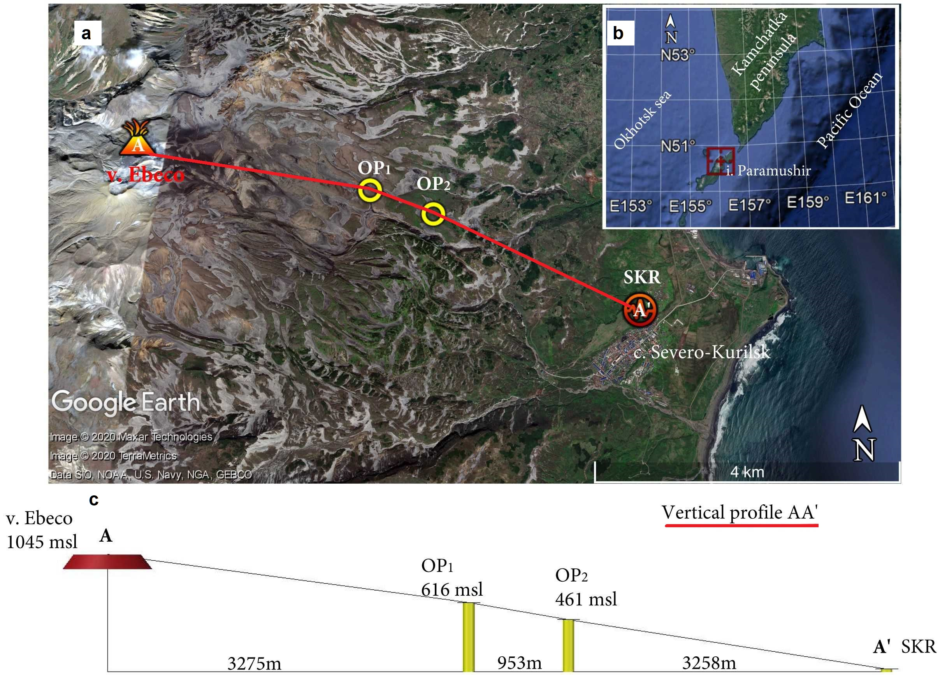
Location of PG observation points

Slide 5
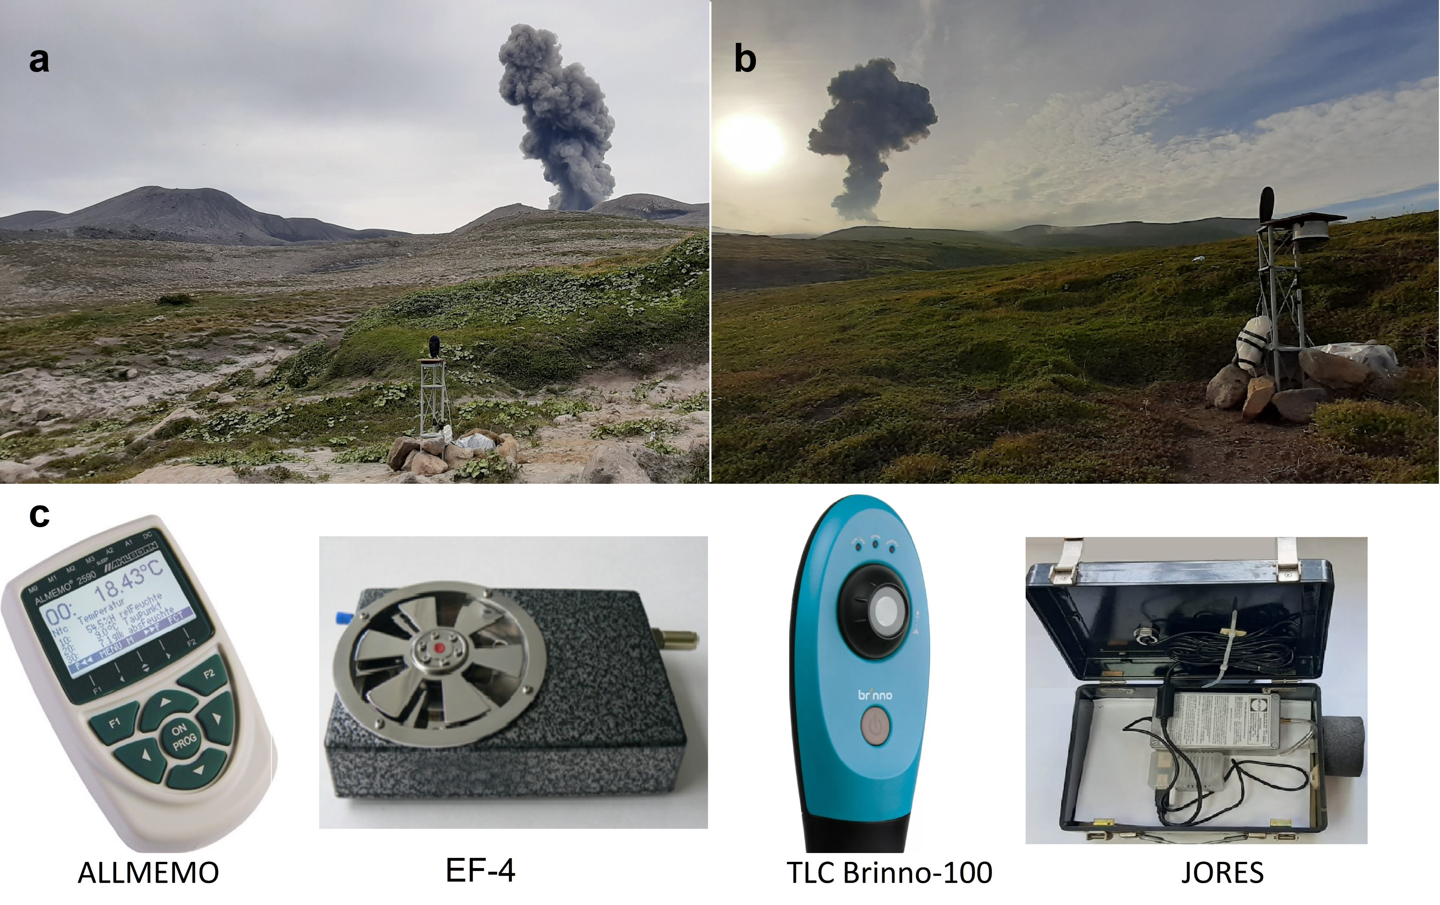
Equipment

Slide 6
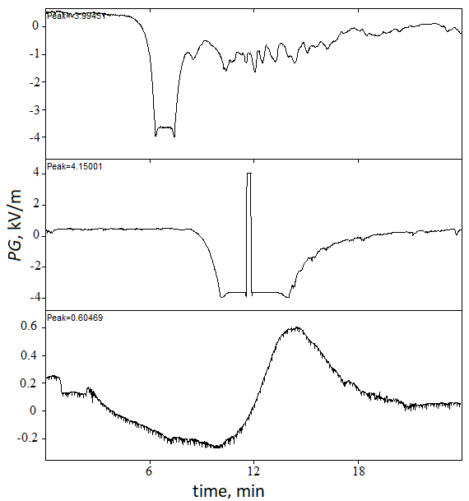
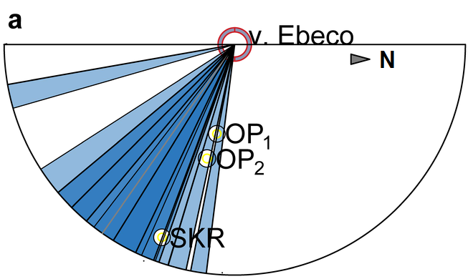
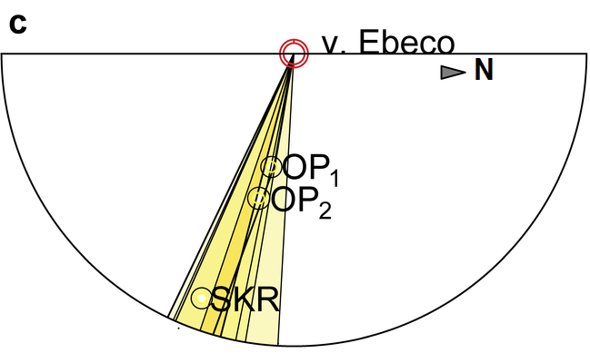
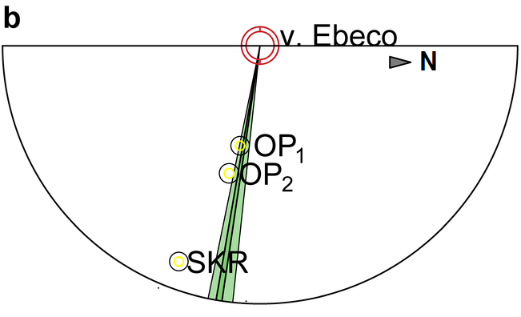
Examples of PG responses registered at OP1
Direction of the VC
Type of
PG signal
V, m/s
I 8 -10 m/s
17 events
II before 15 m/s
5 events
III < 6 м/с
2 events

Slide 7
Field observations
As a result of field observations in the near zone from the crater of the Ebeko volcano, three types of response in the PG to the passage of the VC were registered. The analysis of the conditions of the VC propagation revealed the relationship of the observed responses of the PG with the features of the VC propagation. Apparently, the conditions of propagation of the lower region of the VC relative to the surface have a decisive role in the formation of bulk charges of the VC.
To confirm the discovered regularity of the observed responses in the PG variations from the VC propagation conditions, we have carried out physical simulation of the formation and propagation of VC with simultaneous registration of PG. The task of physical simulation was to repeat types of responses of the PG revealed during field observations.

Slide 8
Physical simulation

Slide 9
PG response records
Field observations
Physical simulation

Slide 10
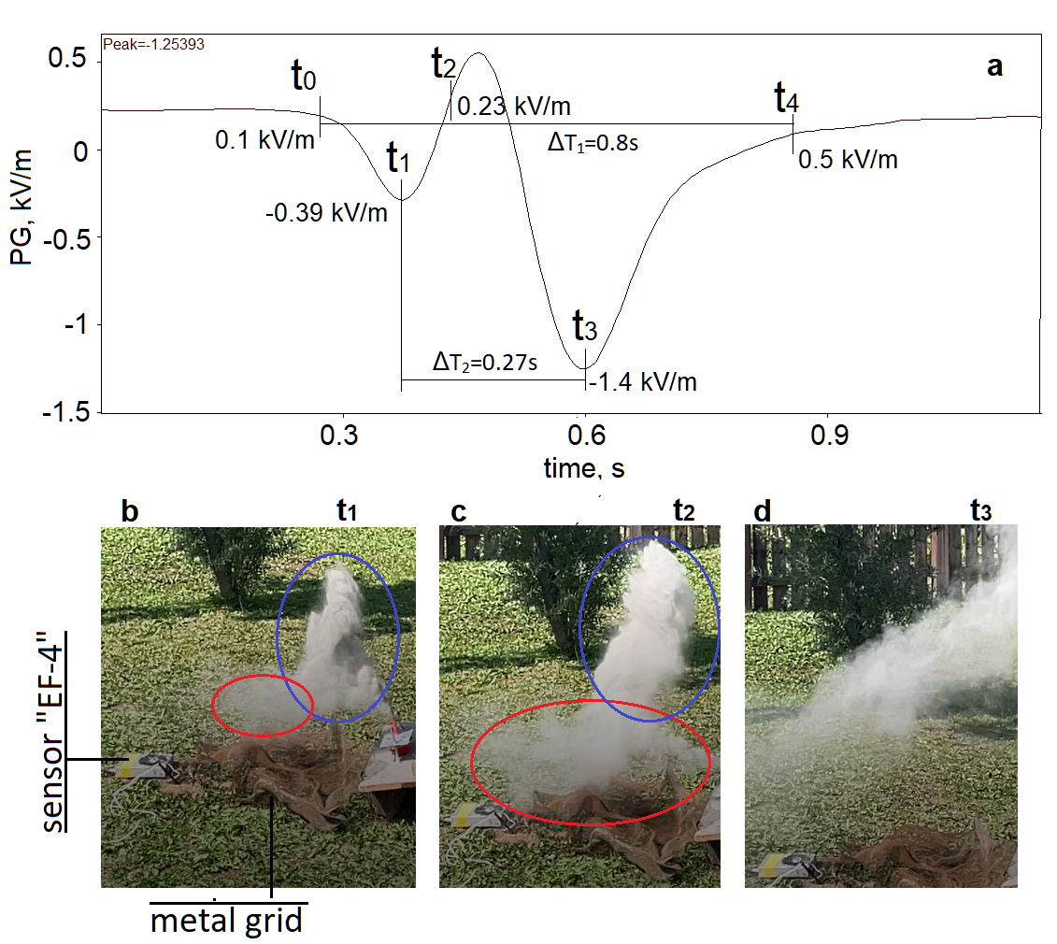
Example of simulation of type II response in PG

Slide 11
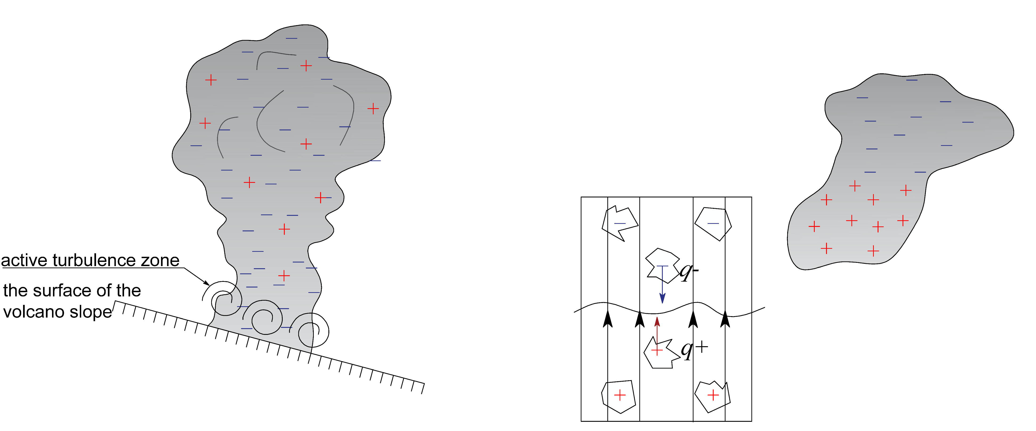
A physical model of the bipolar charge formation in a VC

Slide 12
A physical model of the bipolar charge formation in a VC
Q=4-7 C

Slide 13
A physical model of the bipolar charge formation in a VC
Q=4-7 C
E_{z}
the effect of electrostatic induction

Slide 14
A physical model of the bipolar charge formation in a VC
Q=4-7 C
E_{z}
the conditional boundary between the positively charged and negatively charged area of VC
E_{z}
the effect of electrostatic induction

Slide 15
A physical model of the bipolar charge formation in a VC
Q=4-7 C
E_{z}
the conditional boundary between the positively charged and negatively charged area of VC
E_{z}
the effect of electrostatic induction

Slide 16
Conclusions
As a result of field observations on the Ebeko volcano (Paramushir Island, Russia) and physical simulation of ash clouds with simultaneous registration of the PG, we revealed a phenomenological feature of the formation of a volumetric electrostatic charge in the lower region of the VC, while this charge will be opposite to the main charge of the VC. This effect is possible if the lower region of the VC has a direct interaction with the surface of the slope of the volcano. And we suppose that this process is amplified and to some extent controlled by the effect of induced induction on the surface of the slope of the volcano.
The revealed phenomenological feature of the formation of differently polar volume charges in the VC is a new knowledge about the electrification of the VC from explosive volcanic eruptions.
Based on the conducted field observations of PG and physical simulation, a new physical model of the formation of a dipole charge in VC is proposed.

Slide 17
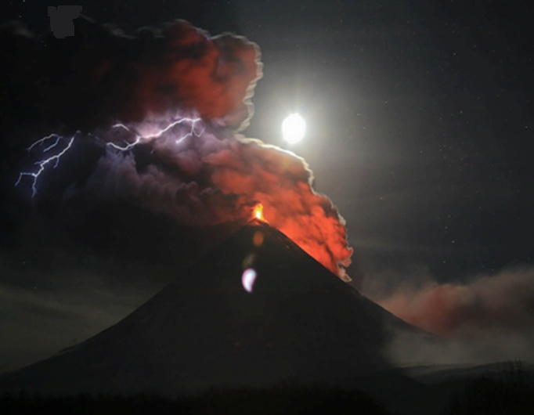
THANKS FOR THE ATTENTION!

Slide 18
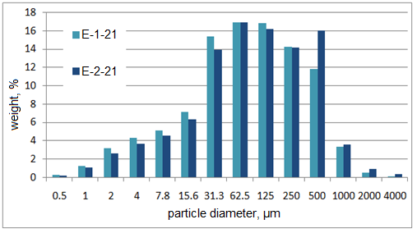
The results of determining the content of the main elements in the studied samples (%).
Test | SiO ₂ | Al₂О₃ | FeO | Fe₂О₃ | MnО | MgО | CaО | Na₂О | K₂О | P₂О₅ | Σ
E-1-21 E-2-21 | 56.8 | 17.54 | 5.09 | 2.31 | 0.14 | 2.9 | 7.82 | 4.38 | 2.11 | 0.17 | 99,26
The results of determining the granulometric composition of the ash samples E-1-21 and E-2-21.

