Slide 1
Impact of solar activity on the optical properties of the thermosphere
Boris Shevtsov
Far Eastern Branch of the Russian Academy of Sciences
Institute of Cosmophysical Research and Radio Wave Propagation

Slide 2
Abstract
The mechanisms of the influence of solar activity on the optical characteristics of the thermosphere and the possibility of studying them using lidar observations and monitoring the glow of the night sky are considered. The need for an integrated approach to remote observations is substantiated by the example of the dynamics of spectral lines of optical emission over Kamchatka, which arises as a result of changes in the state of the thermosphere, and which can be used for remote lidar sensing in adaptive mode.
Notes:
Механизмы влияния солнечной активности на климатические изменения связаны прежде всего с влиянием солнечной активности на оптические характеристики атмосферы.

Slide 3
Аннотация
Рассмотрены механизмы влияния солнечной активности на оптические характеристики термосферы и возможность их изучения с помощью лидарных наблюдений и мониторинга свечения ночного неба. Необходимость комплексного подхода к дистанционным наблюдениям обоснована на примере динамики спектральных линий оптического излучения над Камчаткой, которая возникает в результате изменения состояния термосферы и которая может быть использована для дистанционного лидарного зондирования в адаптивном режиме.

Slide 4
Resonance scattering and fluorescence
Thermosphere as Ultraviolet Converter
Pump band
R
heater
2
S
Pumping with ultraviolet of sun light
1
normal
neutral
inverse population
R
cooler
Ground state
Scattering coefficient
Efficiency or
Gain factor

Slide 5
Scattering coefficient of the atmosphere
Shevtsov, B.M., Perezhogin, A.N., Seredkin, I.N.: Atmospheric Optical Characteristics in the Area of 30-400 km. Remote Sens. 14, 6108 (2022) https://doi.org/10.3390/rs14236108
Notes:
Два направления развития термосферных лидарных исследований.

Slide 6
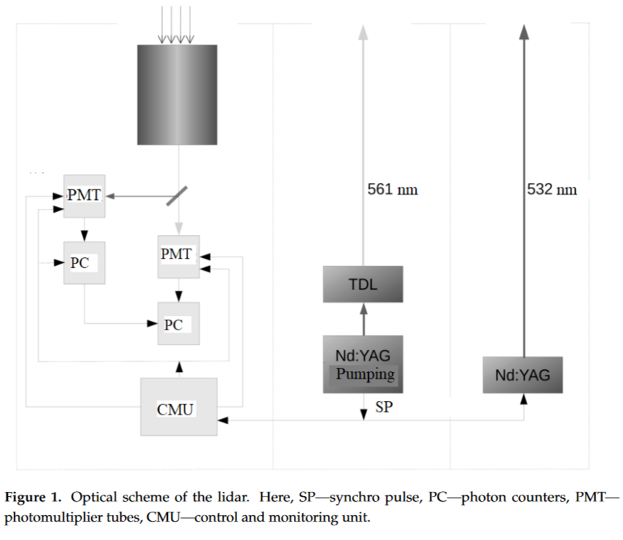
O+ and N+ Lidar at Paratunka
O⁺
N⁺

Slide 7
F2 regain Lidar observation
Bychkov, V.V., Perezhogin, A.S., Seredkin, I.N., Shevtsov B. M.: Appearance of light-scattering layers in the thermosphere of Kamchatka during the autumn of 2017. Proc. SPIE 10833, 10833A4 (2018)
Kaifler, B., Geach, C., Bdenbender, H.C., Mezger, A., Rapp, M.: Measurements of metastable helium in Earths atmosphere by resonance lidar. Nat. Commun. 13, 6042 (2022)
Lifang Du, Haoran Zheng, Chunlei Xiao, Xuewu Cheng, Fang Wu, Jing Jiao, Yuchang Xun, Guotao Yang: The all-solid-state narrowband lidar developed by optical parametric oscillator/amplifier (OPO/OPA) technology for simultaneous detection of the Ca and Ca+ layers. Remote Sens. 2023, 15(18), 4566; https://doi.org/10.3390/rs15184566
____________________________________________
Raizada, S., Smith, J. A., Lautenbach, J., Aponte, N., Perillat, P., Sulzer, M., Mathews, J.D.: New Lidar Observations of Ca+ in the Mesosphere and Lower Thermosphere Over Arecibo. Geophysical Research Letters 47(5), e2020GL08711 (2020) https://doi.org/10.1029/2020GL087113
Notes:
Два направления развития термосферных лидарных исследований.

Slide 8
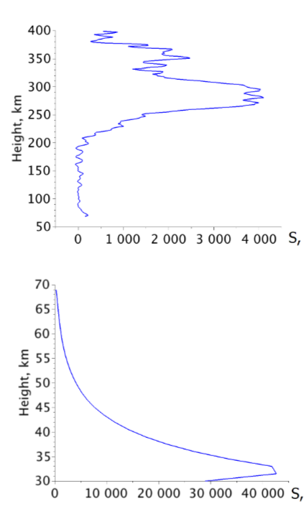
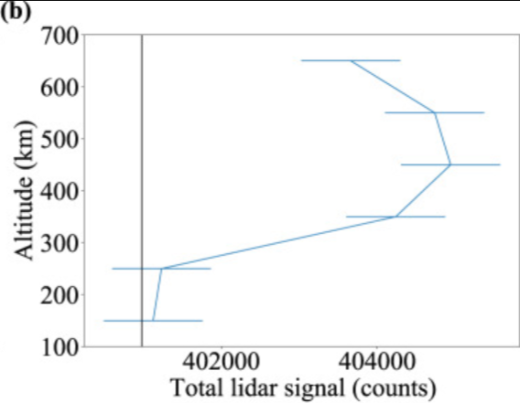
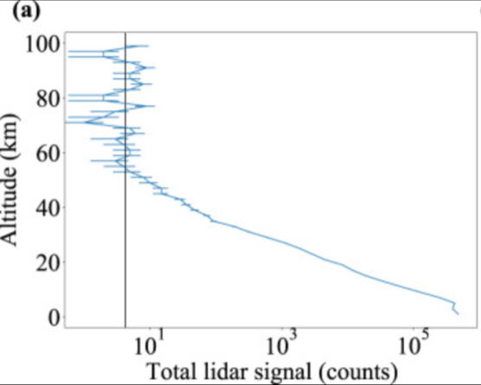
Ramstein, Germany
Kamchatka, Russia

Slide 9
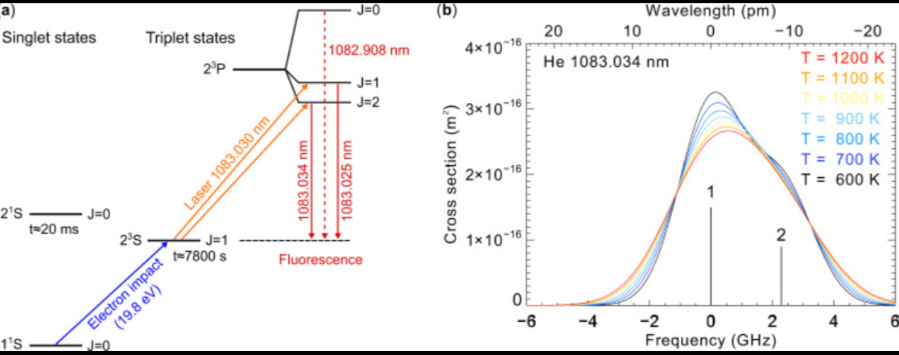
He 1083 nm Lidar transition

Slide 10
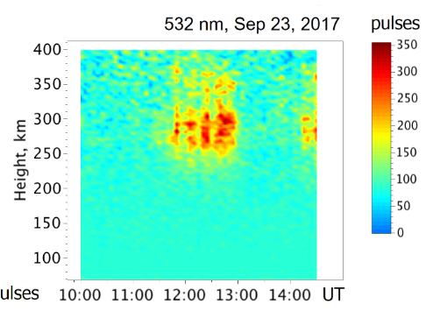
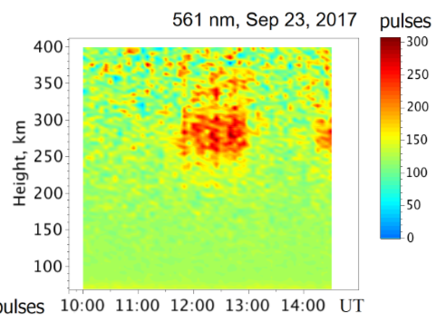
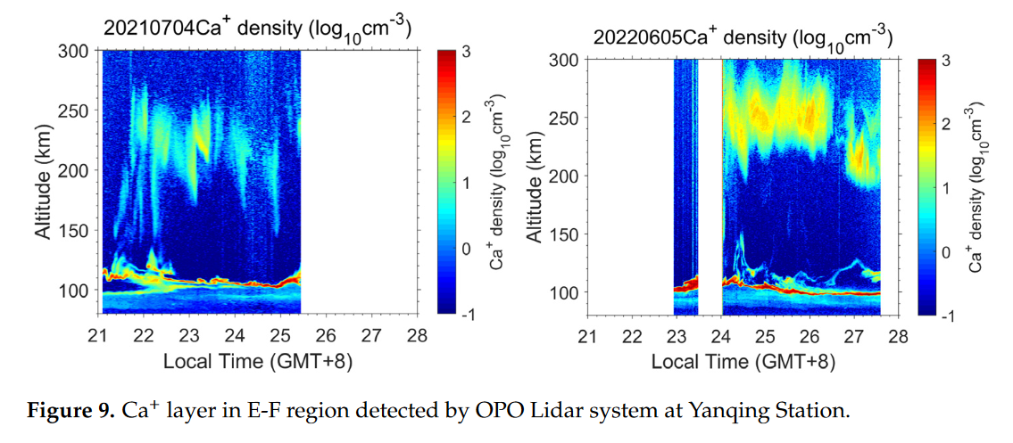
N⁺
O⁺
N+ and O+ layers in E-F region detected by Lidar system at Paratunka Station.
λ = 393 nm
, China.

Slide 11
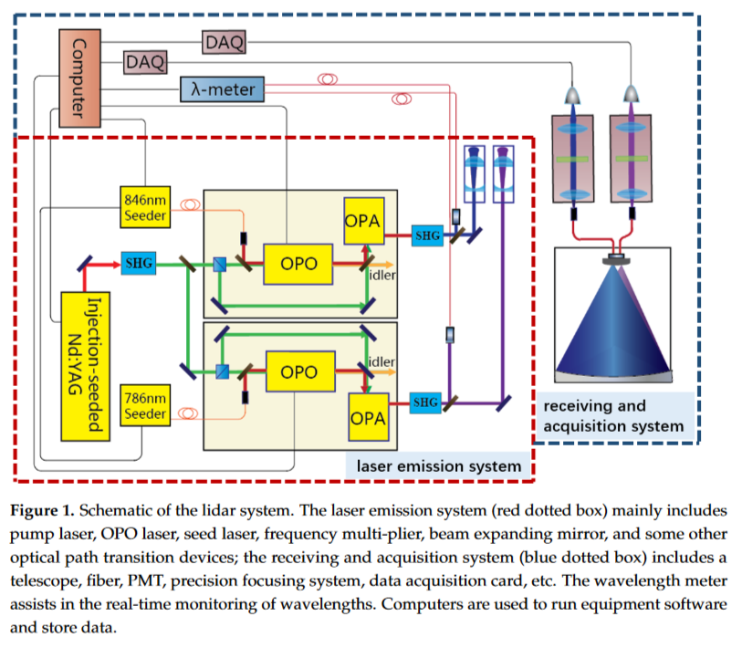
423 nm
Ca and Ca+ Lidar system at Yanqing Station, China.
393 nm
Seeger -- Neodymium-doped gadolinium orthovanadate.
Notes:
Ортованадат гадолиния, легированный неодимом,

Slide 12
Complex observations in normal and inverse populations
Pump band
R
2
S
Pumping with ultraviolet of sun light
Scattering signal
1
normal
Emission
inverse population
Spectroanalyzer
Lidar
Spectroanalyzer
Emission
R
Ground state
Scattering coefficient

Slide 13
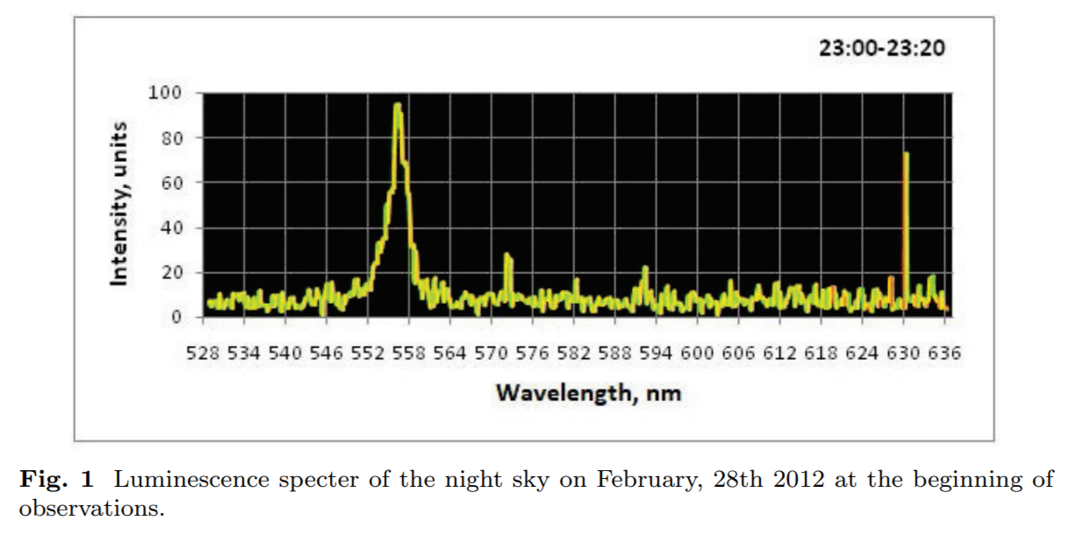
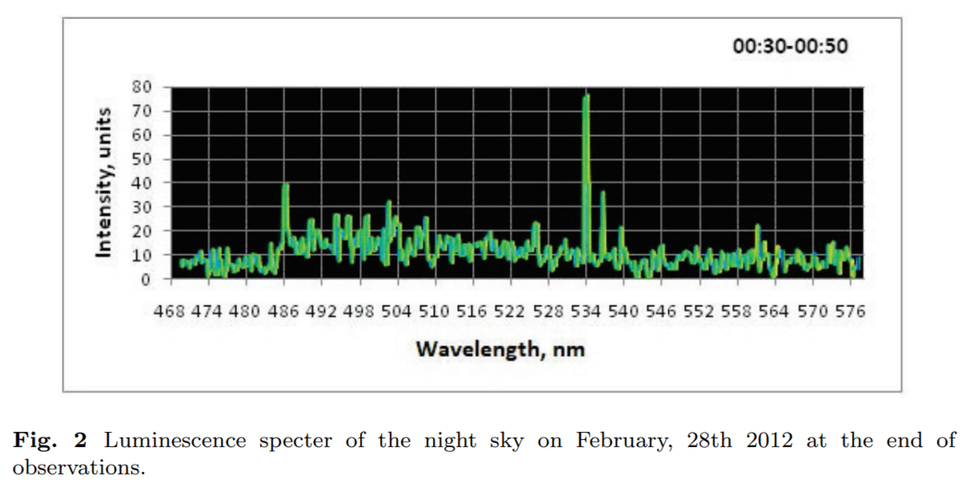
Spectral analysis of the night sky glow over Kamchatka
Data were obtained over Kamchatka on February 28, 2012 using an SP-2500i spectrophotometer with a PicoStar HR 12 picosecond camera and a telescope aimed at the zenith with a mirror diameter of 60 cm and a focal length of 2 m, coordinates: 5258’23”N, 15814’ 50”E, in a quiet geomagnetic environment, all K-indices were equal to 1. The observation time was 1 hour 50 minutes with two signal accumulation sessions of 20 minutes each, at the beginning and at the end of this period.

Slide 14
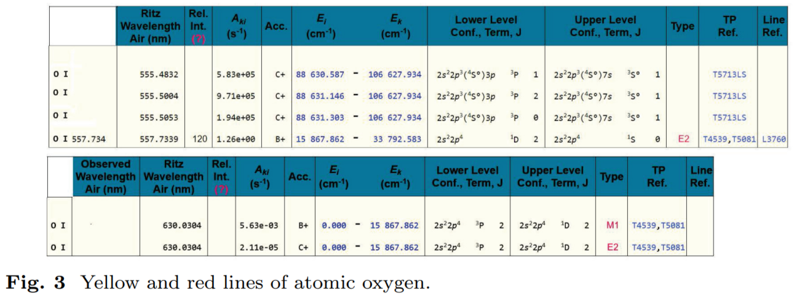
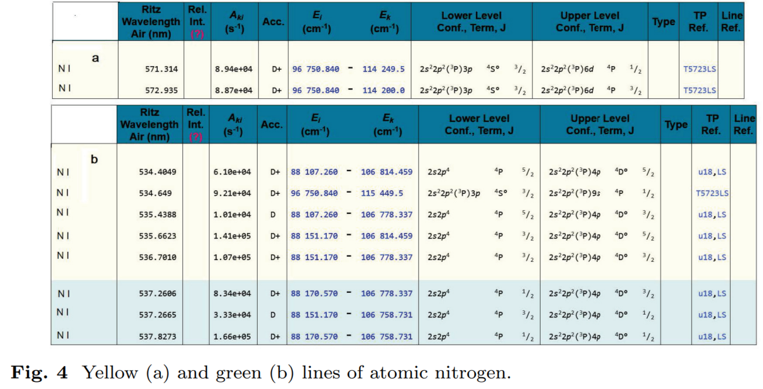
The beginning of observations, fig. 1
End of observations, fig. 2

Slide 15
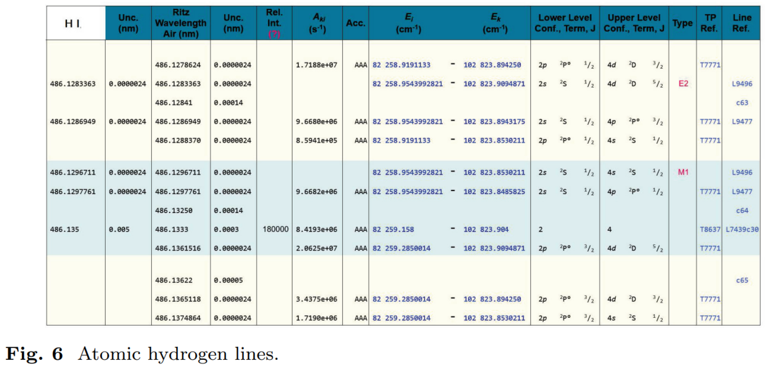
End of observations, fig. 2
O II and H are the components of the upper thermosphere.
And with them for company, N with green line.

Slide 16
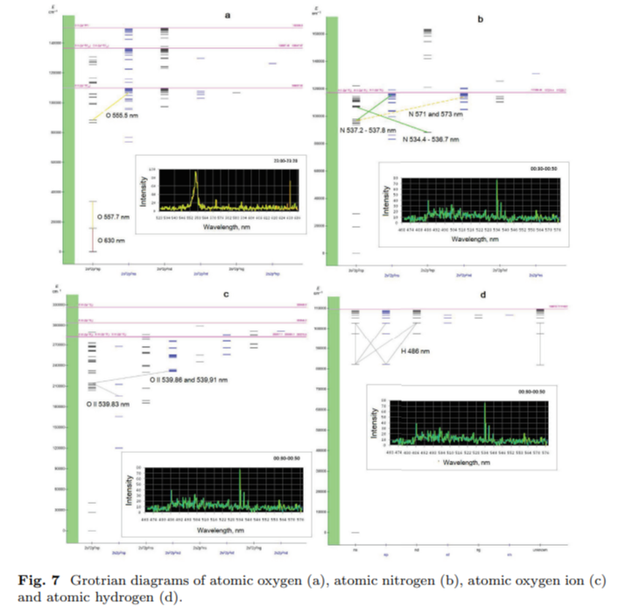

Slide 17
Характеристики лидарных спектральных линий
Comp.
He I
Ca I
Ca II
Ne
Ne I
Notes:
Ионные термосферные лидары лидируют как 3:1.

Slide 18
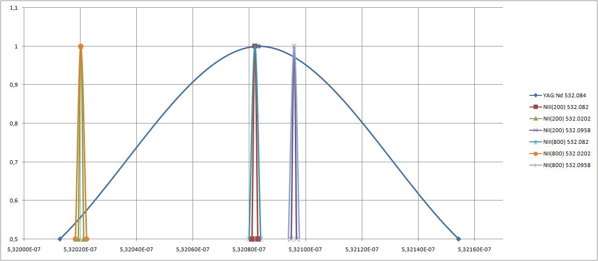
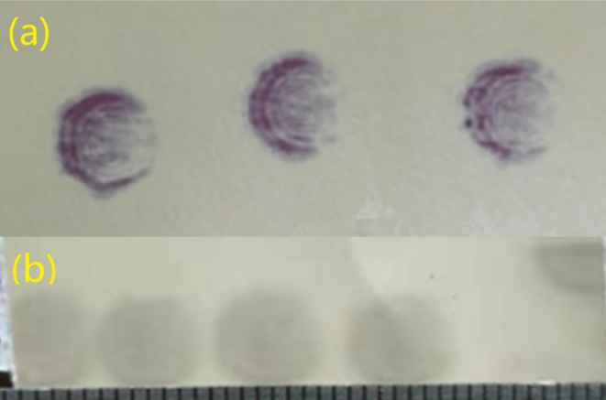
Spectral lines of the nitrogen atom ions transitions lie within the band of second harmonic of the Nd: YAG laser 532.08 ± 0.07 nm
Example of spectral lines of atomic transitions from Catalog NIST ASD, 1978
 |  | Wavelength in Air (nm) | A_{ki} (s⁻¹) | Lower Level | Term | J | Upper Level | Term | J
1 | NII | 532.0202 | 4.20e+07 | 2s2p²(⁴P)3p | ⁵P° | 2 | 2s2p²(⁴P)3d | ⁵P | 1
2 | NIII | 532.087 | 5.68e+07 | 2s2p(³P°)3p | ²D | 5/2 | 2s2p(³P°)3d | ²F° | 7 /2
3 | NII | 532.0958 | 2.52e+07 | 2s2p²(⁴P)3p | ⁵P° | 1 | 2s2p²(⁴P)3d | ⁵P | 2
1
2
3
Dye laser
OPO laser
The density of N⁺ exceeds that of N⁺⁺ at altitudes 200–300 km

Slide 19
Conclusion
Following the rule of selection of atomic transitions for resonant lidar scattering in the thermosphere using the data of spectral analysis of the glow of the night sky, lidar observations can be carried out in adaptive mode when the mechanisms of excitation of the thermosphere change.
Spectral monitoring is necessary both for lidar control and for correct interpretation of lidar data.

