Slide 1
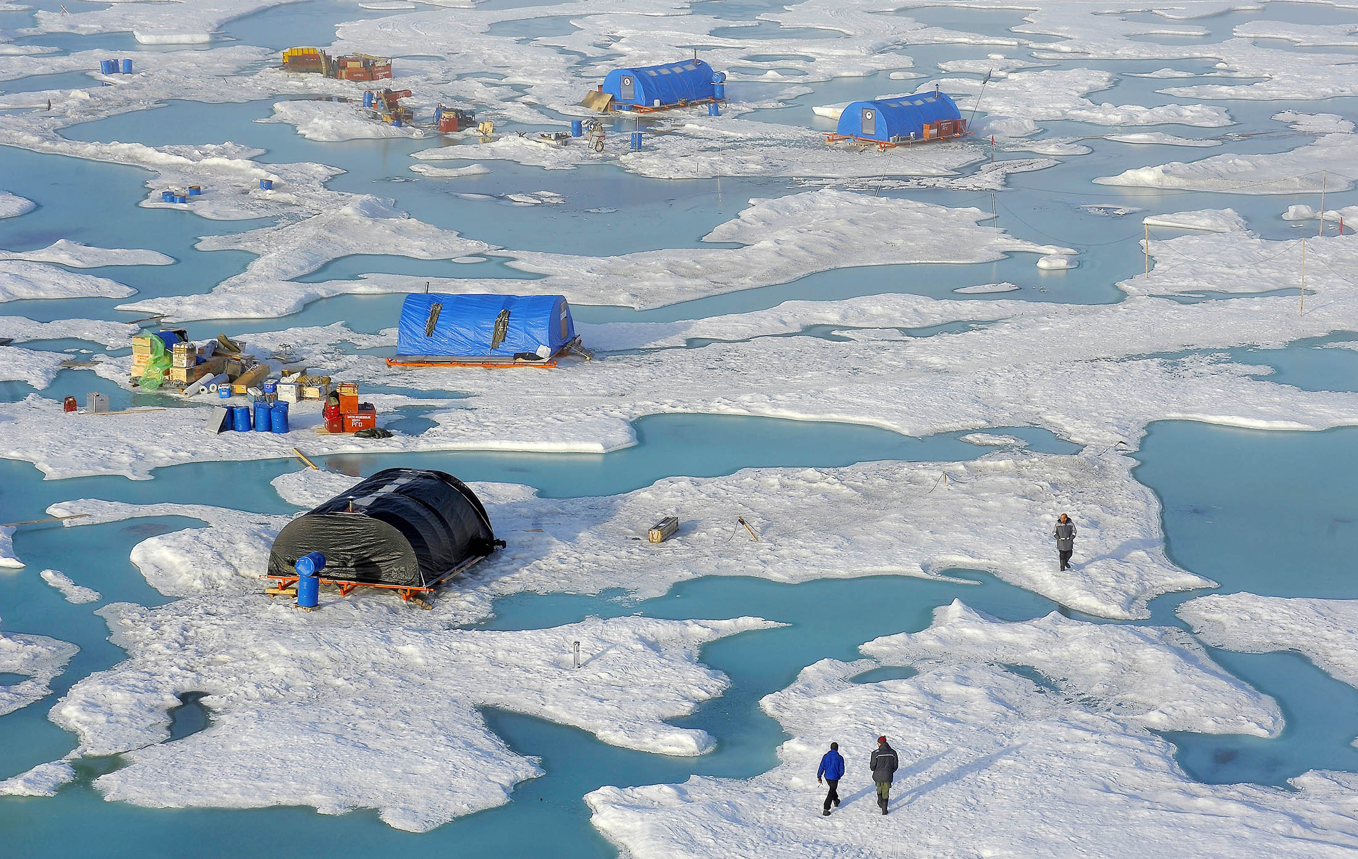
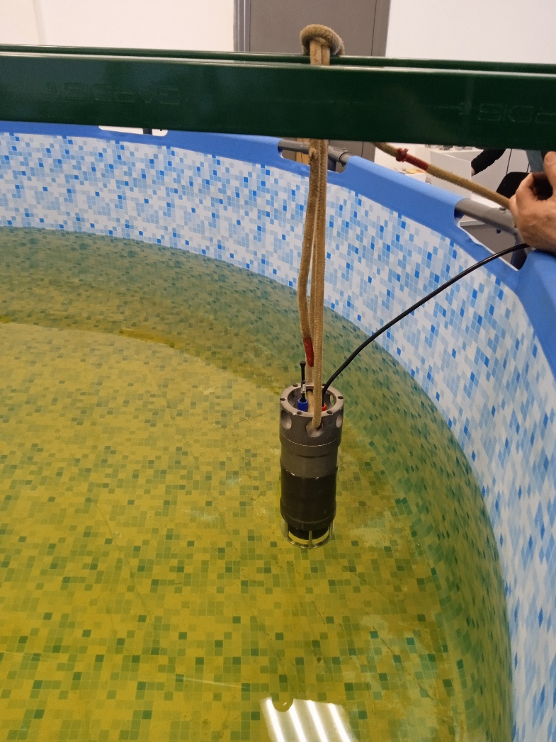
DEVELOPMENT OF ADAPTIVE METHODS OF SYNTHESIS OF HYDROACOUSTIC ANTENNAS USED FOR WORK IN AN ICE ENVIRONMENT
Korochentsev V.I., Jianjun Zhu, Shpak Yu.V., Ryzhikh V.V.

Slide 2
Goal
Development of adaptive synthesis methods that will allow the formation of specified radiation patterns when boundary conditions change on mobile carriers.

Slide 3
Materials and methods
A new synthesis method, which consists in adapting mathematical algorithms that make it possible to calculate the optimal radiation pattern, which takes into account changes in boundary conditions in time and space. The mathematical apparatus of the synthesis is the Fredholm integral equations of the first kind. The kernel of the integral equation is represented by the sum of directed Green's functions. Ill-posed problems (according to J. Hadamard) are solved by various regularization methods. In this case, various proximity criteria are established between the given and implemented radiation patterns. In this work, root mean square proximity criteria are used.

Slide 4
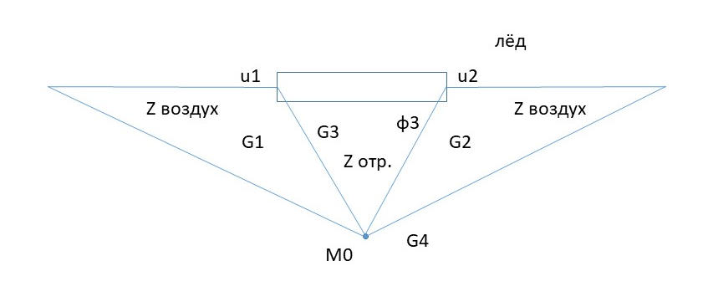
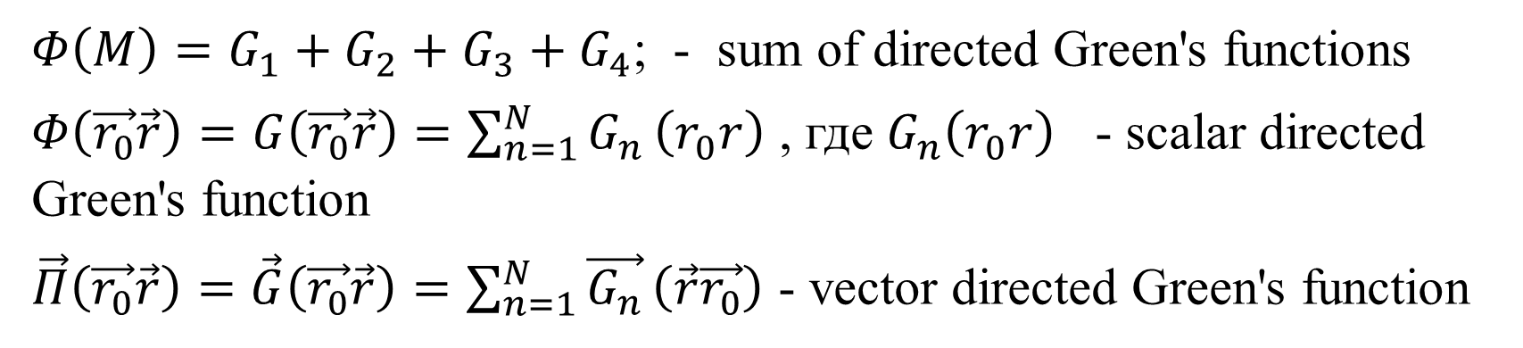
$Φ\left(M\right)=G_{1}+G_{2}+G_{3}+G_{4}$; - sum of directed Green's functions
$Φ\left(\vec{r_{0}}\vec{r}\right)=G\left(\vec{r_{0}}\vec{r}\right)=\sum_{n=1}^{N}{G_{n}}\left(r_{0}r\right)$ , где $G_{n}\left(r_{0}r\right)$ - scalar directed Green's function
$\vec{Π}\left(\vec{r_{0}}\vec{r}\right)=\vec{G}\left(\vec{r_{0}}\vec{r}\right)=\sum_{n=1}^{N}{\vec{G_{n}}}\left(\vec{r}\vec{r_{0}}\right)$ - vector directed Green's function

Slide 5
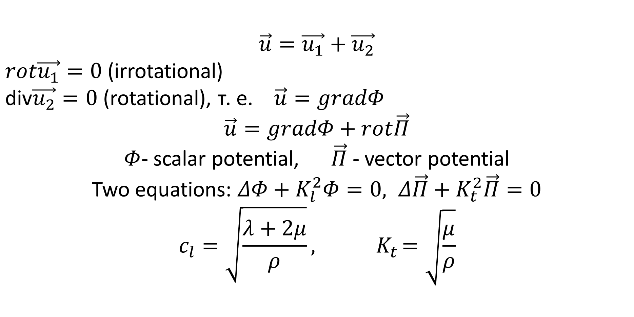
$$\vec{u}=\vec{u_{1}}+\vec{u_{2}}$$
$rot\vec{u_{1}}=0$ (irrotational)
$\text{div}\vec{u_{2}}=0$ (rotational), т. е. $\vec{u}=gradΦ$
$$\vec{u}=gradΦ+rot\vec{Π}$$
$Φ$- scalar potential, $\vec{Π}$ - vector potential
Two equations: $ΔΦ+K_{l}^{2}Φ=0, Δ\vec{Π}+K_{t}^{2}\vec{Π}=0$
$$c_{l}=\sqrt{\frac{λ+2μ}{ρ}}{, K}_{t}=\sqrt{\frac{μ}{ρ}}$$

Slide 6
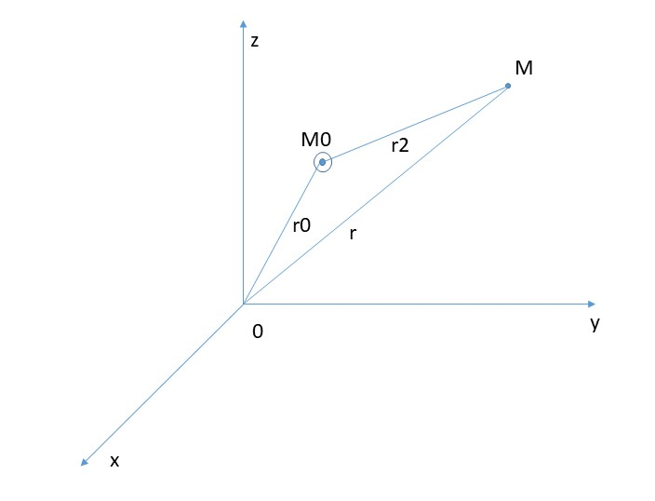
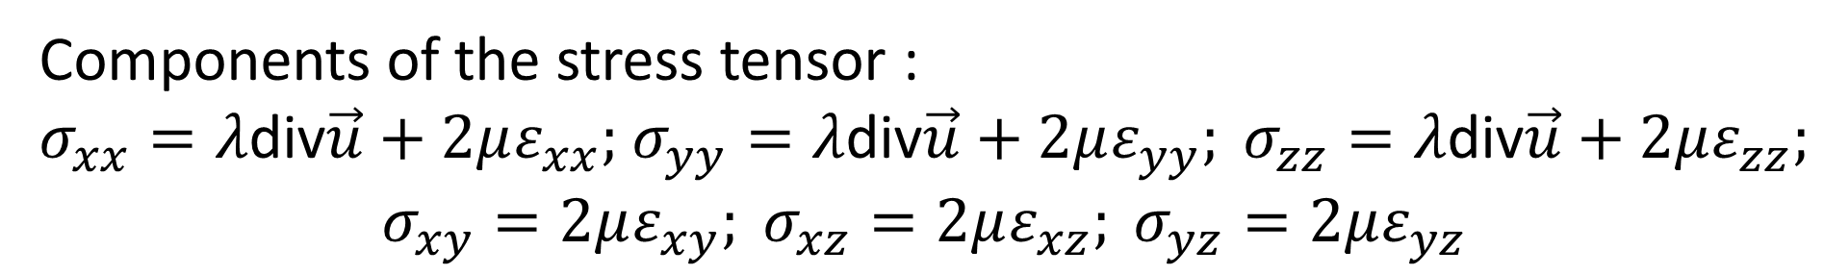
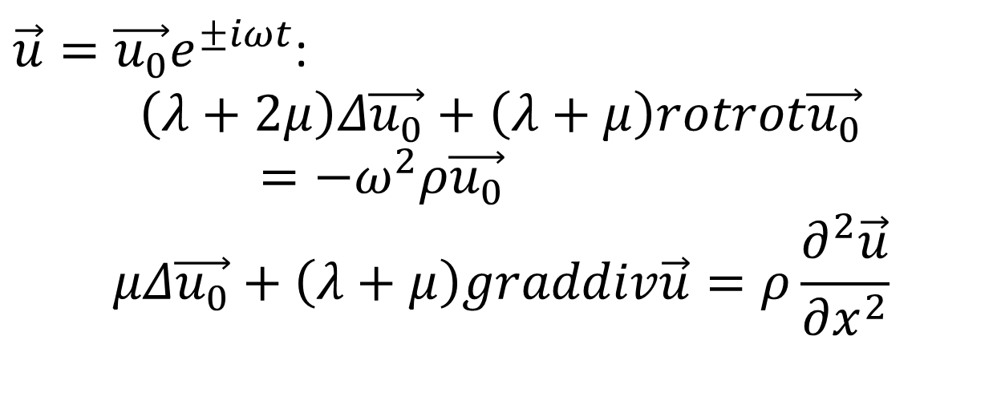
$\vec{u}=\vec{u_{0}}e^{±iωt}$:
$$\left(λ+2μ\right)Δ\vec{u_{0}}+\left(λ+μ\right)rotrot\vec{u_{0}}=−ω^{2}ρ\vec{u_{0}}$$
$$μΔ\vec{u_{0}}+\left(λ+μ\right)graddiv\vec{u}=ρ\frac{∂^{2}\vec{u}}{∂x^{2}}$$
Components of the stress tensor :
$σ_{xx}=λ\text{div}\vec{u}+2με_{xx};$ $σ_{yy}=λ\text{div}\vec{u}+2με_{yy}; σ_{zz}=λ\text{div}\vec{u}+2με_{zz};$
$$σ_{xy}=2με_{xy}; σ_{xz}=2με_{xz}; σ_{yz}=2με_{yz}$$

Slide 7
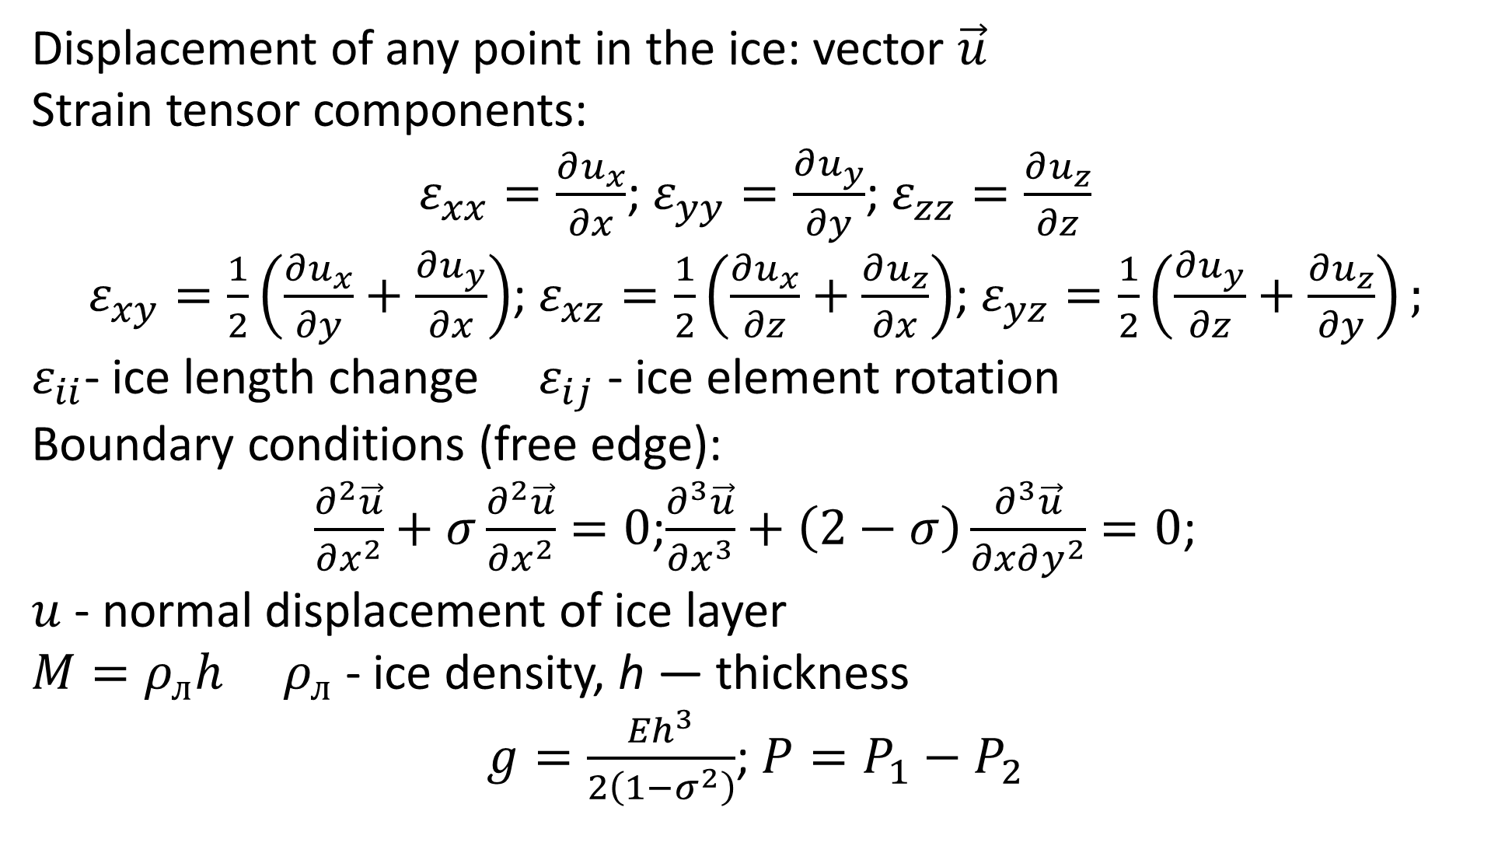
Displacement of any point in the ice: vector $\vec{u}$
Strain tensor components:
$ε_{xx}=\frac{∂u_{x}}{∂x}$; $ε_{yy}=\frac{∂u_{y}}{∂y}$; $ε_{zz}=\frac{∂u_{z}}{∂z}$
$ε_{xy}=\frac{1}{2}\left(\frac{∂u_{x}}{∂y}+\frac{∂u_{y}}{∂x}\right)$; $ε_{xz}=\frac{1}{2}\left(\frac{∂u_{x}}{∂z}+\frac{∂u_{z}}{∂x}\right)$; $ε_{yz}=\frac{1}{2}\left(\frac{∂u_{y}}{∂z}+\frac{∂u_{z}}{∂y}\right);$
$ε_{ii}$- ice length change $ε_{ij}$ - ice element rotation
Boundary conditions (free edge):
$\frac{∂^{2}\vec{u}}{∂x^{2}}+σ\frac{∂^{2}\vec{u}}{∂x^{2}}=0$;$\frac{∂^{3}\vec{u}}{∂x^{3}}+\left(2−σ\right)\frac{∂^{3}\vec{u}}{∂x∂y^{2}}=0$;
$u$ - normal displacement of ice layer
$M=ρ_{л}h$ $ρ_{л}$ - ice density, h — thickness
$g=\frac{{Eh}^{3}}{2\left(1−σ^{2}\right)}$; $P=P_{1}−P_{2}$

Slide 8
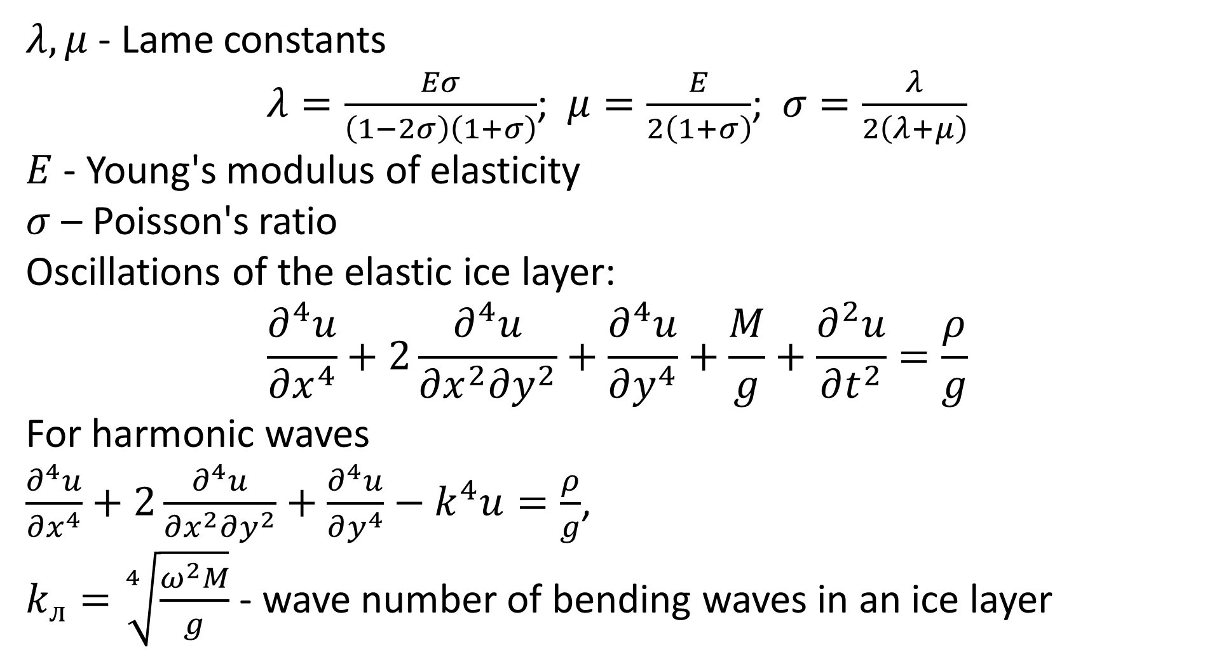
$λ,μ$ - Lame constants
$λ=\frac{Eσ}{\left(1−2σ\right)\left(1+σ\right)}$; $μ=\frac{E}{2\left(1+σ\right)}$;$σ=\frac{λ}{2\left(λ+μ\right)}$
$E$ - Young's modulus of elasticity
$σ$ – Poisson's ratio
Oscillations of the elastic ice layer:
$$\frac{∂^{4}u}{∂x^{4}}+2\frac{∂^{4}u}{∂x^{2}∂y^{2}}+\frac{∂^{4}u}{∂y^{4}}+\frac{M}{g}+\frac{∂^{2}u}{∂t^{2}}=\frac{ρ}{g}$$
For harmonic waves
$\frac{∂^{4}u}{∂x^{4}}+2\frac{∂^{4}u}{∂x^{2}∂y^{2}}+\frac{∂^{4}u}{∂y^{4}}−k^{4}u=\frac{ρ}{g}$,
$k_{л}=\sqrt[4]{\frac{ω^{2}M}{g}}$ - wave number of bending waves in an ice layer

Slide 9
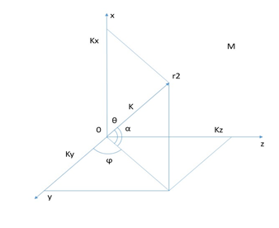
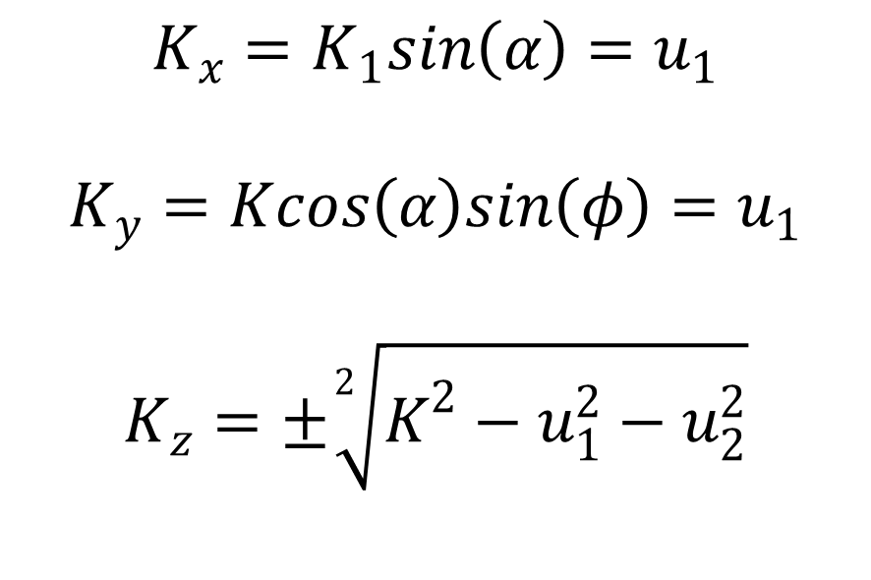
$с_{л}=\frac{ω}{k_{л}}=\sqrt[4]{\frac{ω^{2}M}{g}}$ - flexural wave speed in an ice layer
$$K_{x}=K_{1}sin\left(α\right)=u_{1}$$
$$K_{y}=Kcos\left(α\right)sin\left(φ\right)=u_{1}$$
$$K_{z}=±\sqrt[2]{K^{2}−u_{1}^{2}−u_{2}^{2}}$$

Slide 10
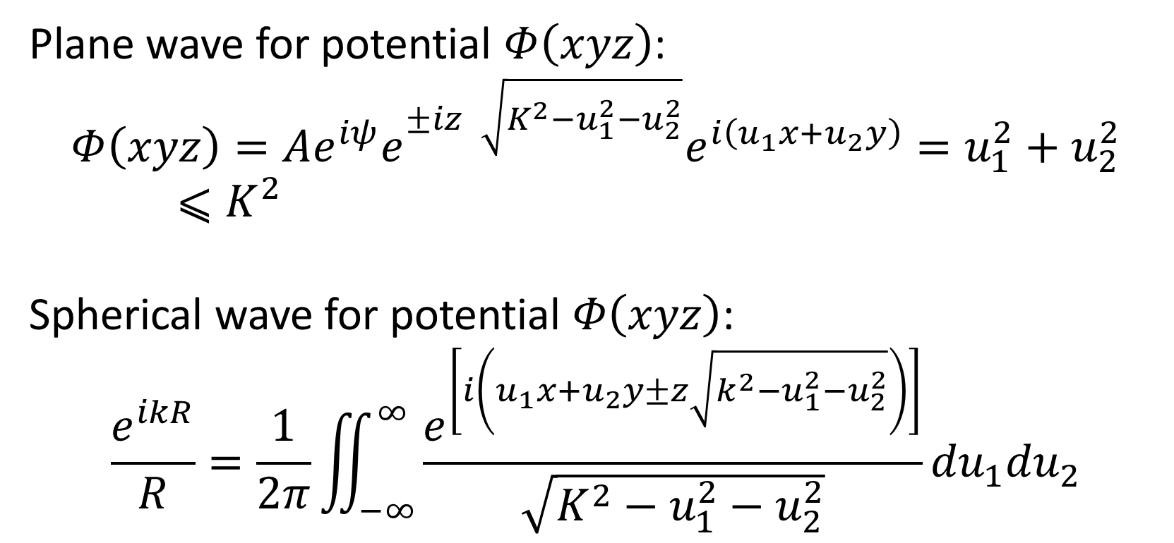
Plane wave for potential $Φ\left(xyz\right)$:
$$Φ\left(xyz\right)=Ae^{iψ}e^{±iz\sqrt{K^{2}−u_{1}^{2}−u_{2}^{2}}}e^{i\left(u_{1}x+u_{2}y\right)}=u_{1}^{2}+u_{2}^{2}⩽K^{2}$$
Spherical wave for potential $Φ\left(xyz\right)$:
$$\frac{e^{ikR}}{R}=\frac{1}{2π}\iint_{−∞}^{∞}{\frac{e^{\left[i\left(u_{1}x+u_{2}y±z\sqrt{k^{2}−u_{1}^{2}−u_{2}^{2}}\right)\right]}}{\sqrt{K^{2}−u_{1}^{2}−u_{2}^{2}}}}{du}_{1}{du}_{2}$$

Slide 11
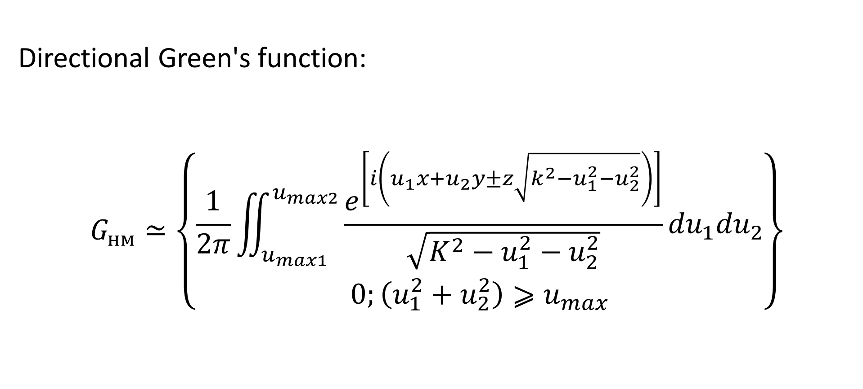
Directional Green's function:
$$G_{нм}≃\left\{\begin{aligned}\frac{1}{2π}\iint_{u_{max1}}^{u_{max2}}{\frac{e^{\left[i\left(u_{1}x+u_{2}y±z\sqrt{k^{2}−u_{1}^{2}−u_{2}^{2}}\right)\right]}}{\sqrt{K^{2}−u_{1}^{2}−u_{2}^{2}}}}{du}_{1}{du}_{2} \\ 0;\left(u_{1}^{2}+u_{2}^{2}\right)⩾u_{max}\end{aligned}\right\}$$

Slide 12
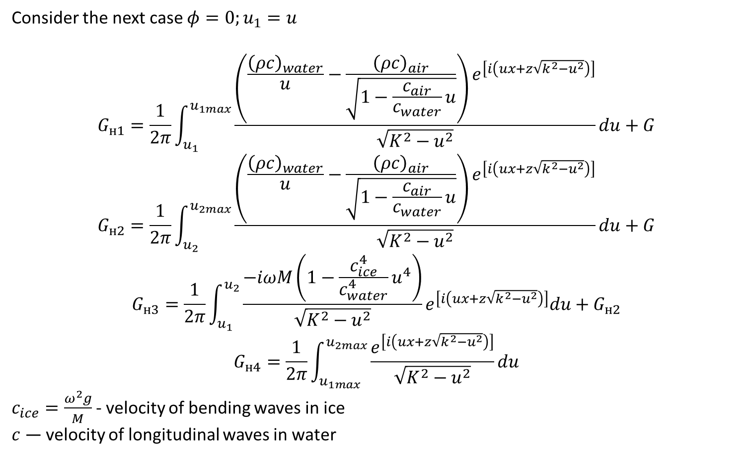
Consider the next case $φ=0;u_{1}=u$
$$G_{н1}=\frac{1}{2π}\int_{u_{1}}^{u_{1max}}{\frac{\left(\frac{{\left(ρc\right)}_{water}}{u}−\frac{{\left(ρc\right)}_{air}}{\sqrt{1−\frac{c_{air}}{c_{water}}u}}\right)e^{\left[i\left(ux+z\sqrt{k^{2}−u^{2}}\right)\right]}}{\sqrt{K^{2}−u^{2}}}}du+G$$
$$G_{н2}=\frac{1}{2π}\int_{u_{2}}^{u_{2max}}{\frac{\left(\frac{{\left(ρc\right)}_{water}}{u}−\frac{{\left(ρc\right)}_{air}}{\sqrt{1−\frac{c_{air}}{c_{water}}u}}\right)e^{\left[i\left(ux+z\sqrt{k^{2}−u^{2}}\right)\right]}}{\sqrt{K^{2}−u^{2}}}}du+G$$
$$G_{н3}=\frac{1}{2π}\int_{u_{1}}^{u_{2}}{\frac{−iωM\left(1−\frac{c_{ice}^{4}}{c_{water}^{4}}u^{4}\right)}{\sqrt{K^{2}−u^{2}}}e^{\left[i\left(ux+z\sqrt{k^{2}−u^{2}}\right)\right]}du+G_{н2}}$$
$$G_{н4}=\frac{1}{2π}\int_{u_{1max}}^{u_{2max}}{\frac{e^{\left[i\left(ux+z\sqrt{k^{2}−u^{2}}\right)\right]}}{\sqrt{K^{2}−u^{2}}}du}$$
$c_{ice}=\frac{ω^{2}g}{M}$ - velocity of bending waves in ice
$c$ — velocity of longitudinal waves in water

Slide 13
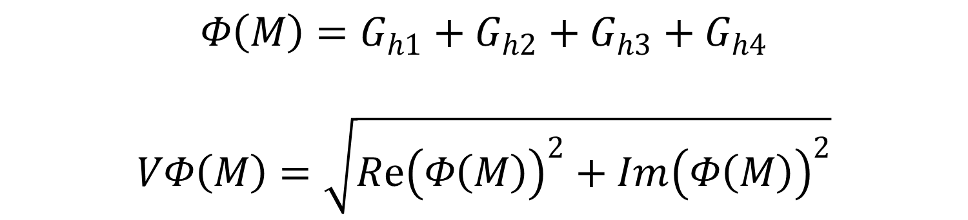
$$Φ\left(M\right)=G_{h1}+G_{h2}+G_{h3}+G_{h4}$$
$$VΦ\left(M\right)=\sqrt{Rе{\left(Φ\left(M\right)\right)}^{2}+Im{\left(Φ\left(M\right)\right)}^{2}}$$

Slide 14
Calculated pressure distribution of a point emitter: PP0(x) – in free space, PP1(x) – taking into account reflection from a layer of sea ice, thickness d = 0.1 m; PP2(x) – taking into account reflection from a layer of sea ice, thickness d → 0.

Slide 15
Calculated pressure distribution of a point emitter: PP1(x) – passed through a layer of sea ice, thickness d = 0.1 m; PP2(x) – passed through a layer of sea ice, thickness d → 0.

Slide 16
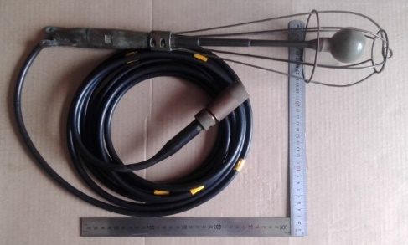
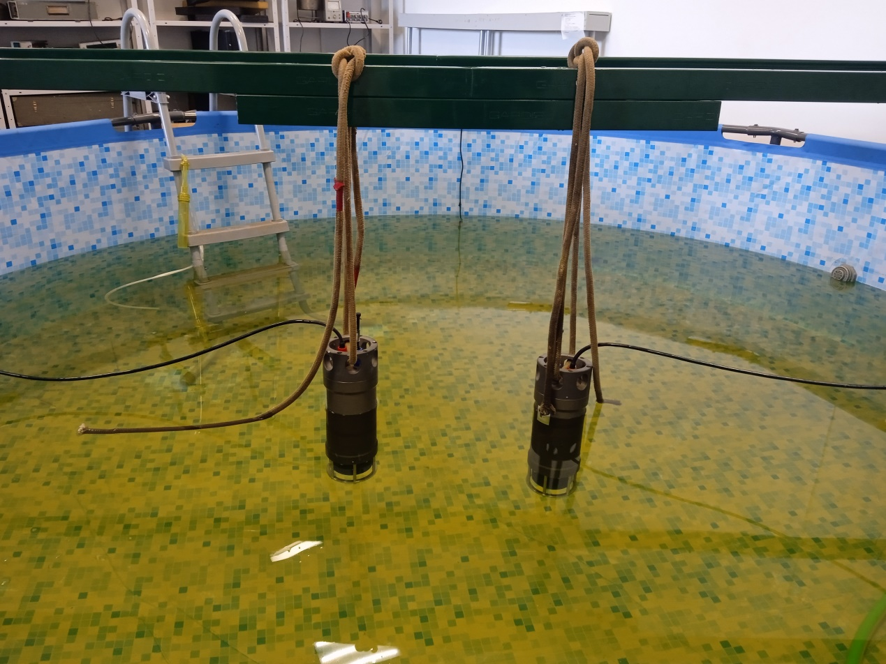
Experimental studies were carried out on the following hydroacoustic and electromagnetic systems:

Slide 17
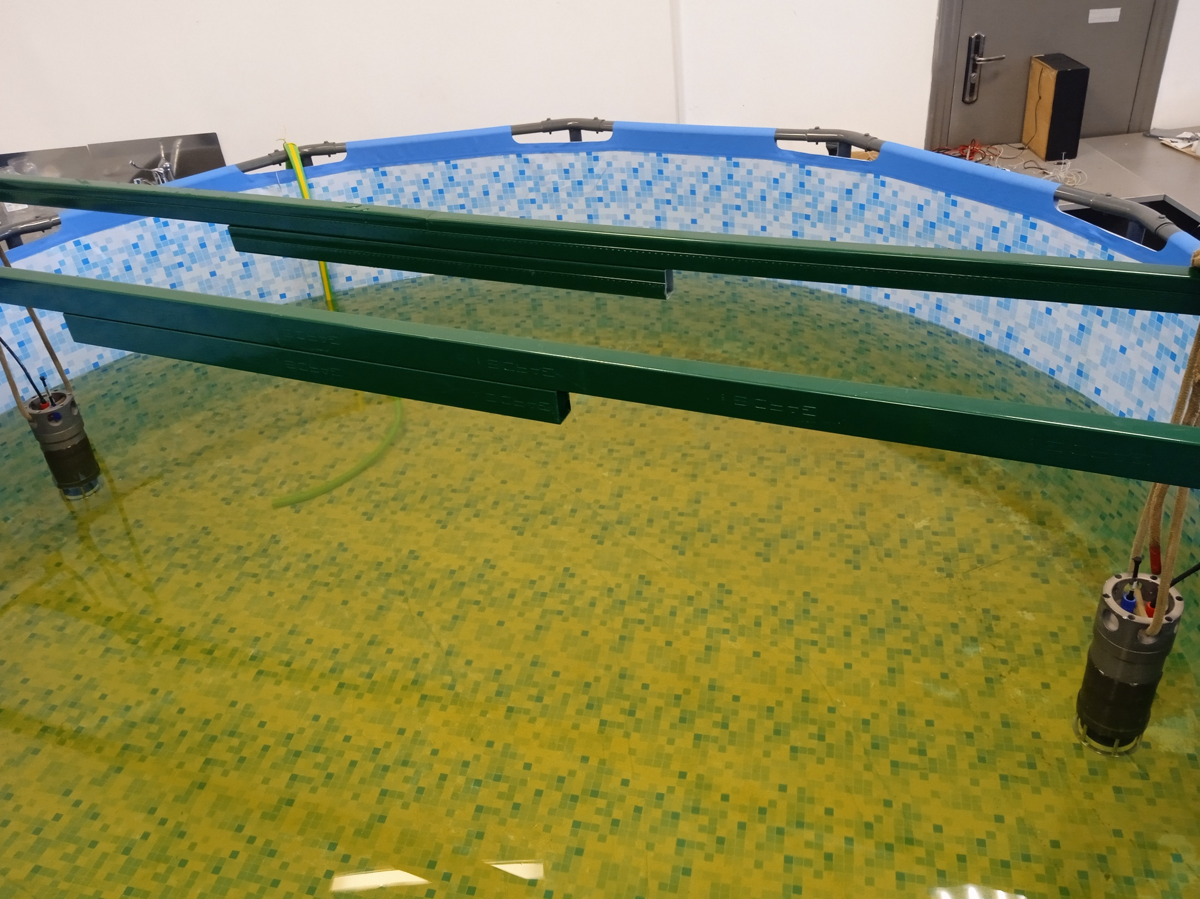

Slide 18
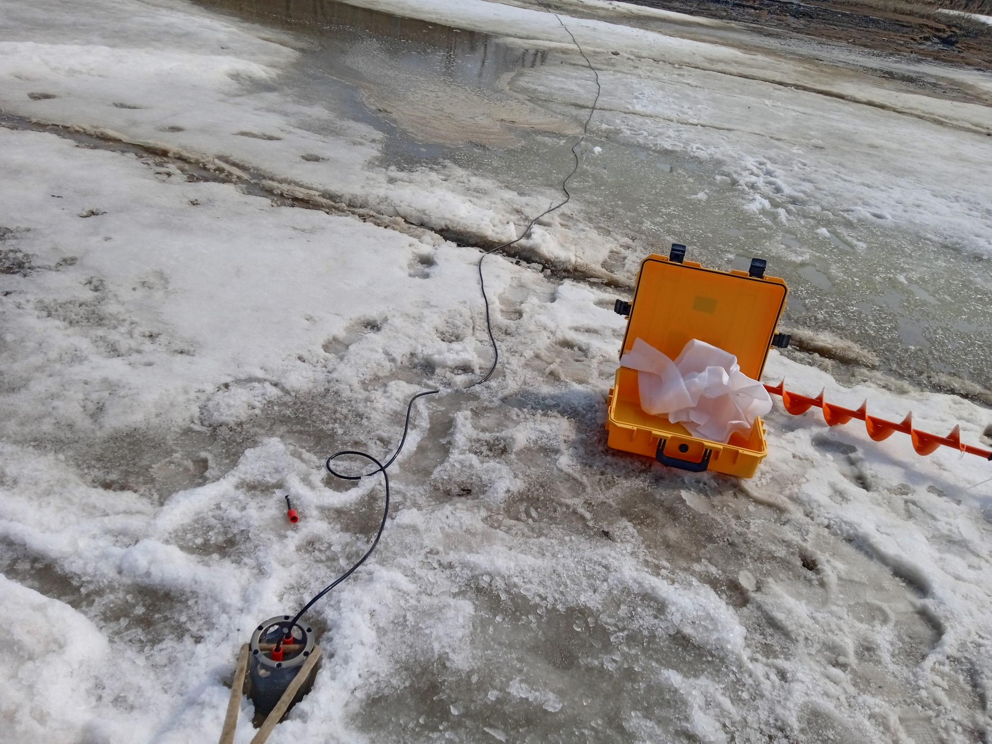

Slide 19
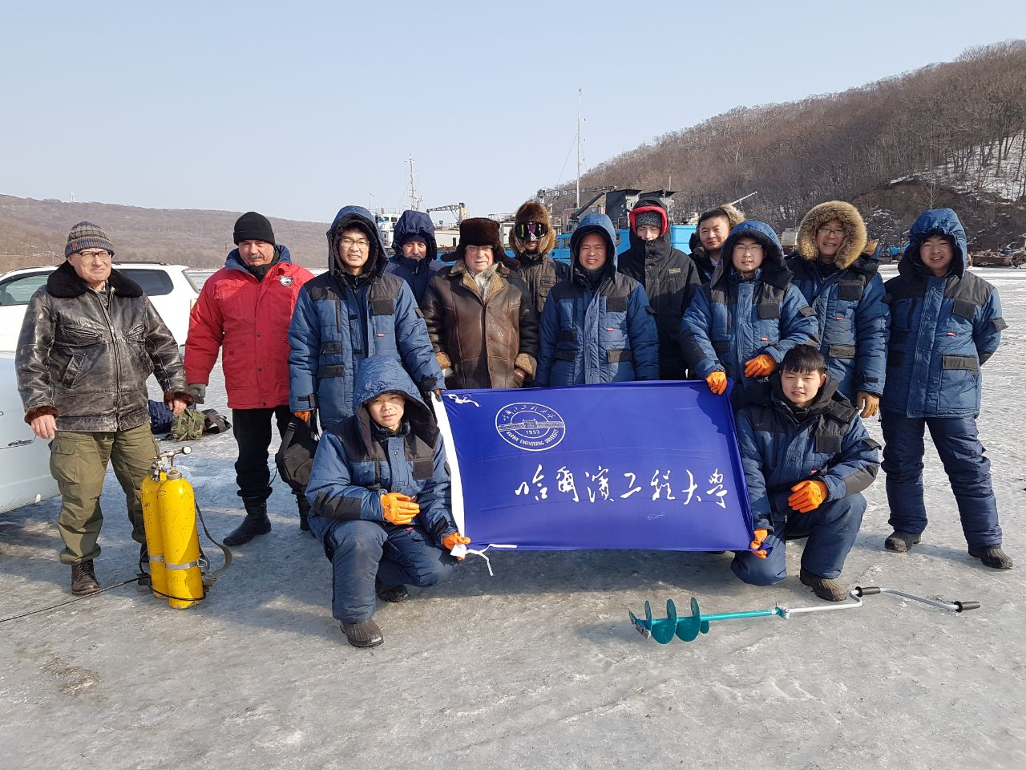

Slide 20
Results
Analytical, correct expressions are obtained. Numerical experiments were carried out for various boundary conditions on ice surfaces. It is shown that the solutions obtained make it possible to carry out calculations on computers of average power.
The results obtained can be used in the development and design of adaptive antennas.

Slide 21
Данная работа выполнена в рамках государственного задания Минобрнауки России в сфере научной деятельности по проекту № FZNS-2023-0008.

Slide 22
Thank you for attention!

